Slide 1
WELCOME TO
DEPARTMENT OF URDU
A.B.M College, Jamshedpur

Slide 2
DEPARTMENT OF URDU
PROFILE
YEAR OF ESTABLISHMENT:-
The department of Urdu was established in 1976. Since the beginning, we have been making effort to improve the overall standard of our students. We instill value and motivate our students to make efforts in doing their best, making improvement each year to achieve greater heights.

Slide 3
OUR BELIEF
OUR STUDENTS GROW, WE GROW

Slide 4
OBJECTIVE
Educate students in both the artistry and utility of the Urdu language through the study of literature and other contemporary forms of culture.
Graduate students who are capable of performing research, analysis, and criticism of literary and cultural texts from different historical periods and genres.

Slide 5
VISION
To help students see themselves as professionals, as part of a discipline with skills and abilities valuable in the business, teaching, publishing, or post-graduate work.
To give students a sense of themselves as citizens of a larger community by encouraging participation in service learning and in diverse and international course work and programming.
To assure that students encounter creativity crucial to Urdu studies through theater productions, readings by professional writers, and their own creative and critical production and presentation.

Slide 6
The Present Team
Presently, the Department of Urdu comprises the following Two staff members:
Dr. Andleeb Umar (Head)
Anjum Ara (Guest Faculty)

Slide 7
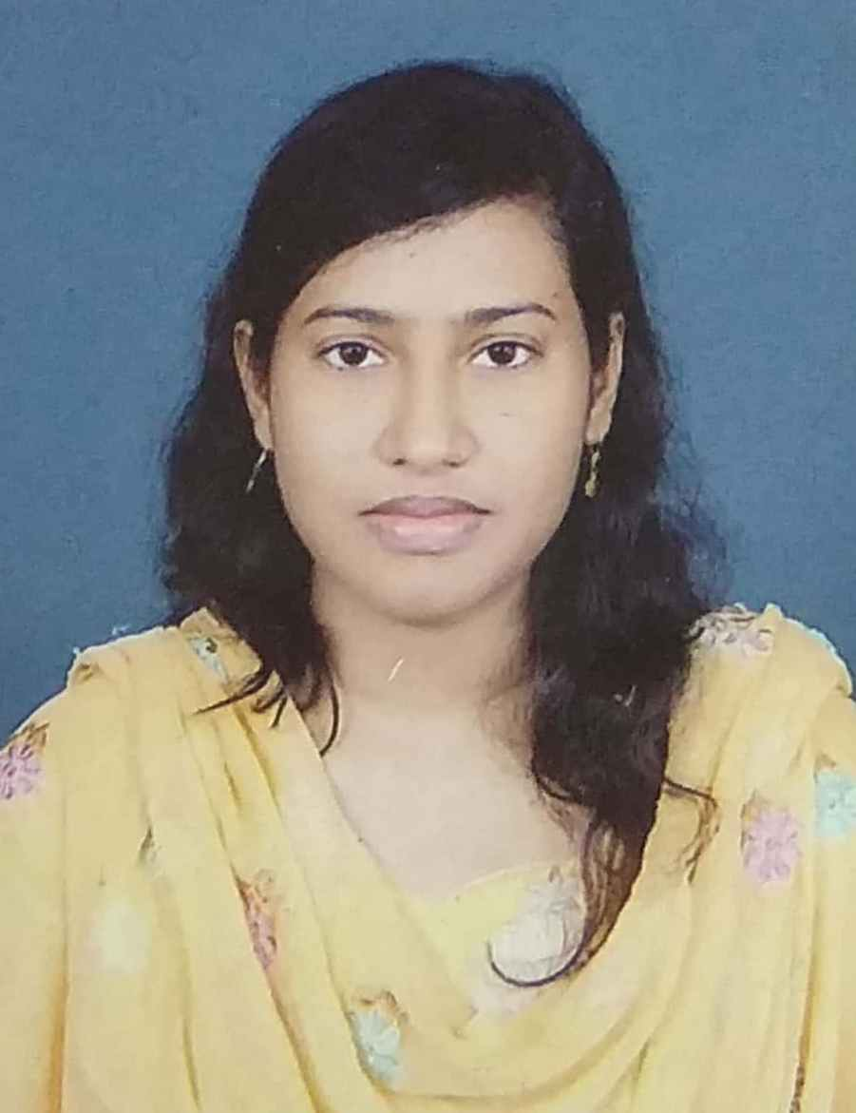
FACULTY PROFILE
Andleeb Umar
Area of Specialization- Prose (Tanqeed, Tahqeeq)
Teaching Experience: 07 years
Paper Published: 14
Seminar Attended: 12
Workshop: 01
Awards: 02
Short Stories: 07
Areas of Interest: Poetry, Literary History, Literary Theory & Criticism.

Slide 8
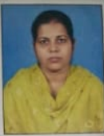
FACULTY PROFILE
ANJUM ARA
Area of Specialization- Prose (Short stories)
Teaching Experience: 01 years
Paper Published: 03
Seminar Attended: 02
Workshop: 01
Areas of Interest: Poetry & Short Stories.

Slide 9
Departmental Events
Departmental Induction
Student Seminars (Syllabus Based)
Parent-Teacher Meeting

Slide 10
Teaching methods adopted to improve student learning
Special interactive classes by applying Group Discussion, Question-Answer, Demonstration method are arranged to encourage the students and thereby improve their learning.
The hidden creativity of the students is manifested through the publication of Wall Magazines and Poster Exhibition in the department.
Interest is grown among the learners by showing them films on different dramas and novels in the syllabus

Slide 11
The teachers of the department are academically motivated to bring out the best in their students, to which effect, they constantly keep themselves updated in their respective areas of specialization.
The students of the department are equally motivated and register enthusiastic presence and participation in all the activities of the department. The department has also constituted a Core Team of sincere and dedicated students volunteers who assist in the administrative functioning of the department.
STRENGTH:-

Slide 12
The Department also organizes extra classes on writing skills for students in order to train them in the art of writing academic answers for university examinations.
The greatest strength of the department has been the teacher-student intimate relationship that has kept the department alive.

Slide 13
Weaknesses
The Department suffers from the non-availability of good reference books for its students.
The fact that most of our students come from the economically under-privileged sections of society, makes it difficult for them to spend money on books of the subjects.

Slide 14
Opportunities
The use of social media platforms for communications with students and promotion of learning opportunities is also visualized as an opportunity.
The students of the department constitute an important bank of creative talent for various literary and cultural activities both within and outside the college.

Slide 15
Challenges
The job mind-set of students and their evaluation of academic learning in vocational terms constitute a significant challenge.
Motivating students for higher education and excellence in the subject, also constitutes a challenge.

Slide 19
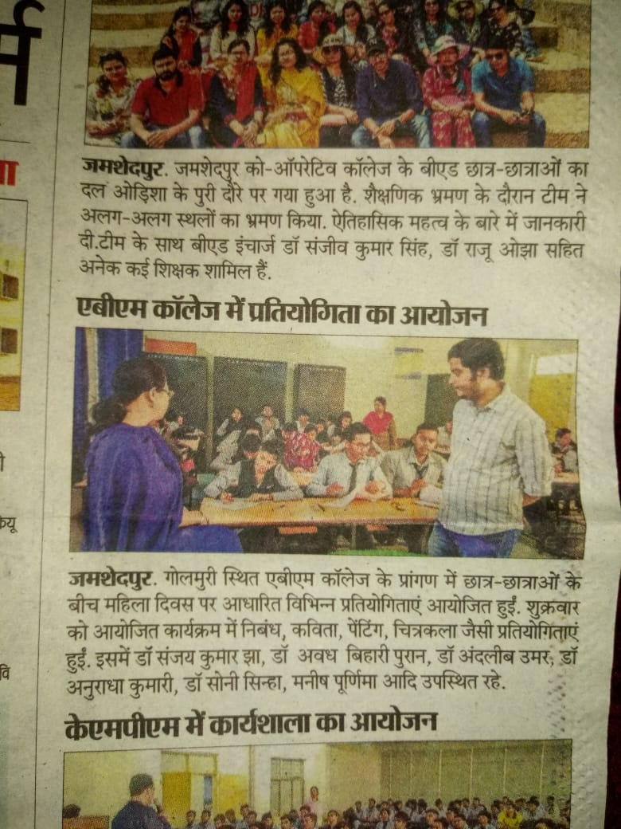
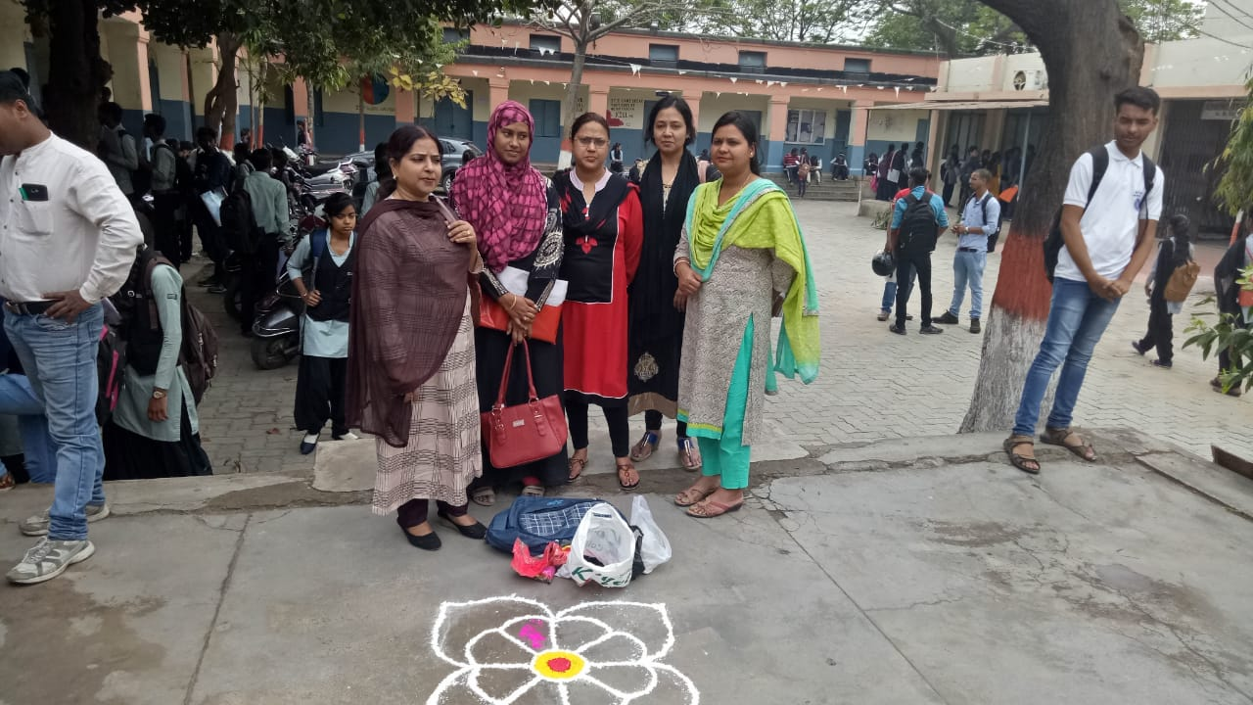
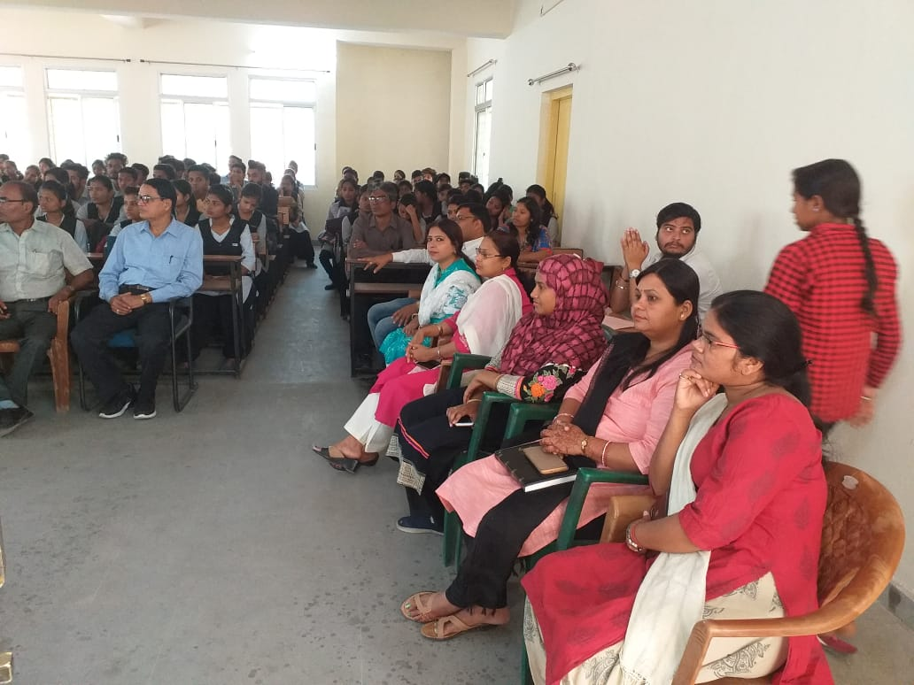
Details of student enrichment programme:

Slide 20
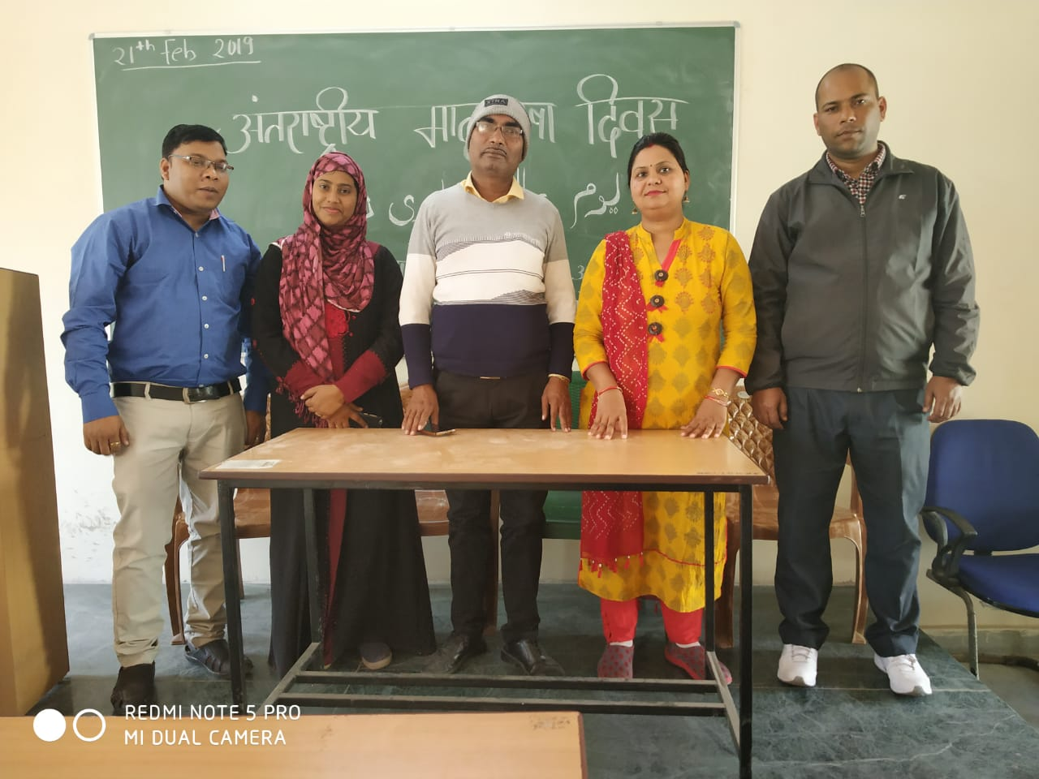
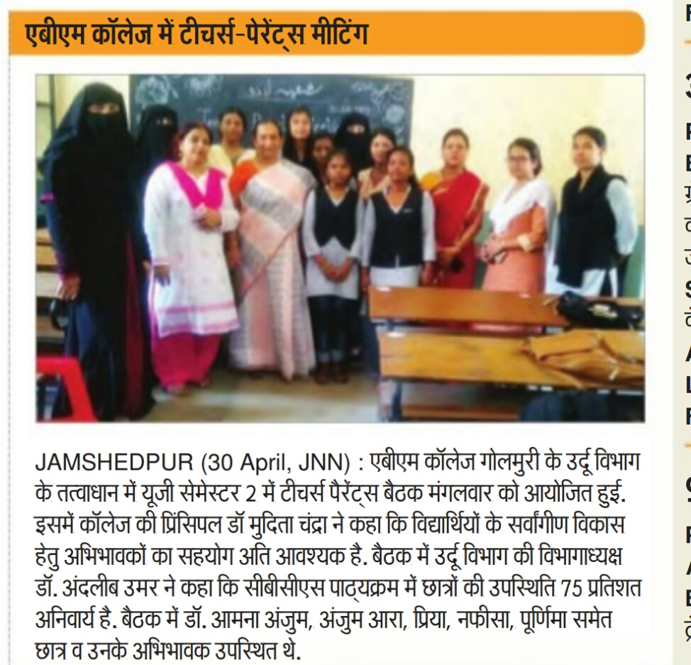
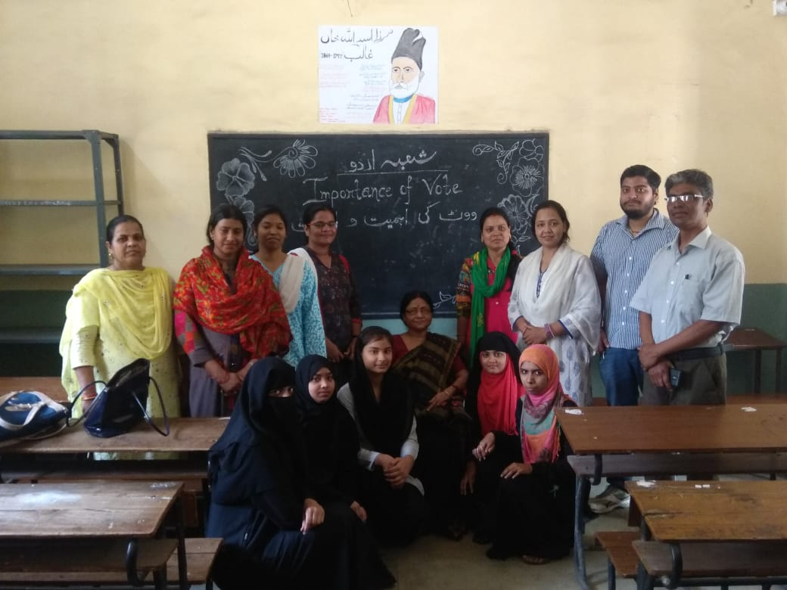
Events At URDU Department

Slide 21
Future plan
The Department, in the coming years, looks forward to the following projects:
Introduction of Post-graduate Teaching
Workshop on Creative Writing and Critical Theory
Organizing a National Seminar

Slide 22
Thank You.

