Slide 1



WELCOME TO ABM COLLEGE
Presented by
Dept of Psychology

Slide 2
Department of Psychology
Established UG :- 1975

Slide 3
Mission
To Promote Human development, Learning Health and well being through high quality education research and services

Slide 4
OUR VISION
To be a department that leads in the teaching, counseling of psychology knowledge

Slide 5
Sanctioned Post | Filled Post
2 | 2

Slide 6
Routine Wise Class distribution
TEACHER | SEM 1&2 |  |  | SEM 3& 4 |  |  | SEM 5& 6
 | HONS | GE | DSC | HON | GE | DSC | HON | DSC
DR AMNA ANJUM | 4 | 1 | 0 | 8 | 2 | 1 | 14 | 1
PRIYA SINGH | 3 | 1 | 1 | 3 | 0 | 1 | 2 | 0

Slide 7
Trust Area of Department
GENERAL PSYCHOLOGY
BIO-PSYCHOLOGY
ABNORMAL PSYCHOLOGY
CLINICAL PSYCHOLOGY
SOCIAL PSYCHOLOGY
HEALTH PSYCHOLOGY
RESEARCH METHODOLOGY

Slide 8
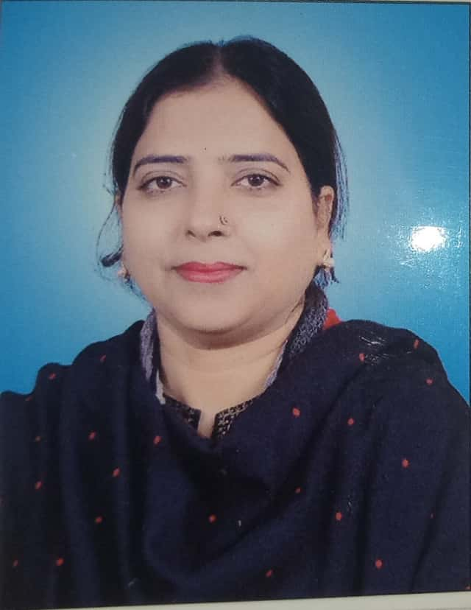
Faculty member
Dr. Amna Anjum
M.A,P.HD (ASSISTANT PROFESSOR)
Area of Specialization:-Clinical Psychology
Teaching Experience :- 01 Yr.
PUBLICATION:- SOCIAL DEVELOPMENT (1)
DATE OF JOINING:- 07-May-2018
SEMINAR - NATIONAL 2
WORKSHOP NATIONAL 1

Slide 9
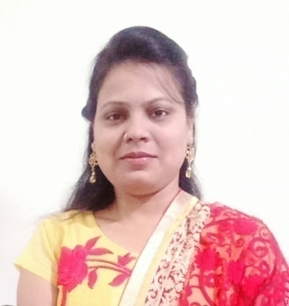
Faculty member
PRIYA SINGH
M.A, B.ED, M.ED (ASSISTANT PROFESSOR CONT..)
Area of Specialization- Clinical Psychology
Teaching Experience 6 Months
SEMINAR - INTERNATIONAL 1
NATIONAL 2
WORKSHOP NATIONAL 2

Slide 10
Teaching Method
The method of instruction are through lecture, class work, tutorials, work assignments followed by discussion and face to face interaction.
Extra Classes are organized during working days depending on the convenience of the students as well as faculty members.

Slide 11
Activities
Women’s Day 08.03.2019
Debate 25.03.2019
Personality Development Skill 30.4.2019

Slide 12
Seminars
Topic | Speaker | Date
Teachers Day | Dr Amna Anjum | 5-Sept-2018
Spl. Lect Research Methodology | Dr. Amna Anjum | 11-Sept-2018
Counseling | Dr. Zaki Akthar | 2-2-2019

Slide 13
ADMISSION IN UG
YEAR | GEN |  | SC |  | ST |  | OBC |  | DA |  | MINORITY
 | F | M | F | M | F | M | F | M | F | M | F | M
2014-17 | 8 | 3 | 0 | 0 | 1 | 0 | 0 | 0 | 0 | 0 | 0 | 0
2015-18 | 22 | 5 | 0 | 0 | 0 | 0 | 0 | 0 | 0 | 0 | 0 | 0
2016-19 | 10 | 4 | 1 | 0 | 0 | 1 | 0 | 0 | 0 | 0 | 0 | 0
2017-20 | 11 | 0 | 0 | 0 | 1 | 0 | 0 | 0 | 0 | 0 | 0 | 0
2018-19 | 19 | 1 | 0 | 0 | 0 | 0 | 0 | 0 | 0 | 0 | 0 | 0

Slide 15
STUDENTS SUCCESS RATE
 | APPEAED | PASSED | FAIL | PASS%
2014 | 9 | 3 | 6 | 33.33
2015 | 12 | 8 | 4 | 66.67
2016 | 17 | 13 | 4 | 76.47
2017 | 15 | 3 | 12 | 20
2018 | 20 | 14 | 6 | 70

Slide 16
PUBLICATION BY FACULTY & FACULTY WHO HAVE PRESENTED IN NATIONAL AND INTERNATIONAL SEMINARS/CONFERENCE
DR AMNA ANJUM-01(SOCIAL PSYCHOLOGY)
INTERNATIONAL SEMINAR:-Nil
NATIONAL SEMINAR:- 2
WORKSHOP:- 1
PRIYA SINGH
INTERNATIONAL SEMINAR:- 1
NATIONAL SEMINAR:- 2
WORKSHOP:- 2

Slide 17
NUMBER OF BOOKS IN THE DEPARTMENT LIBRARY - 100
NUMBER OF JOURNALS AND PERIODICALS- 2
NUMBER OF COMPUTER- 1

Slide 18


INOVATIONS INTRODUCED AND IMPROVEMENTS
COUNSELLING
(ACADEMIC AND PERSONAL)

Slide 19
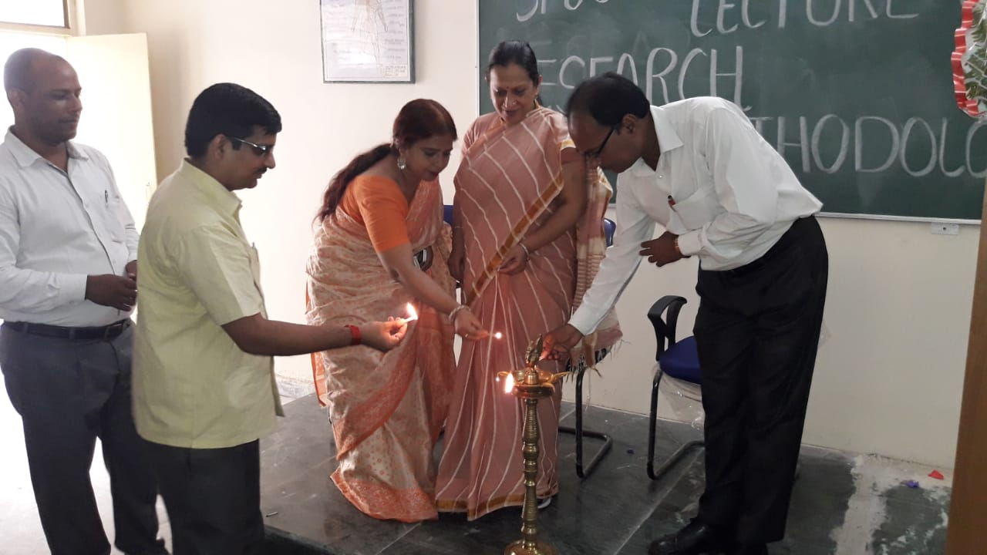
Departmental Events
Spl. Lect. Research Methodology

Slide 20
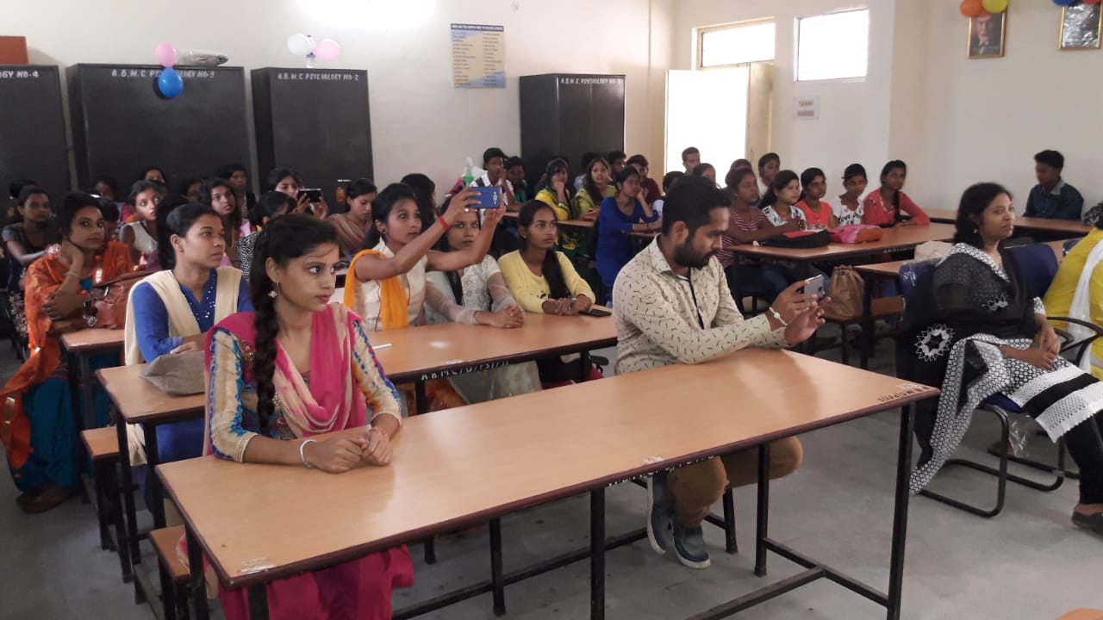
TEACHERS DAY CELEBRATION

Slide 21
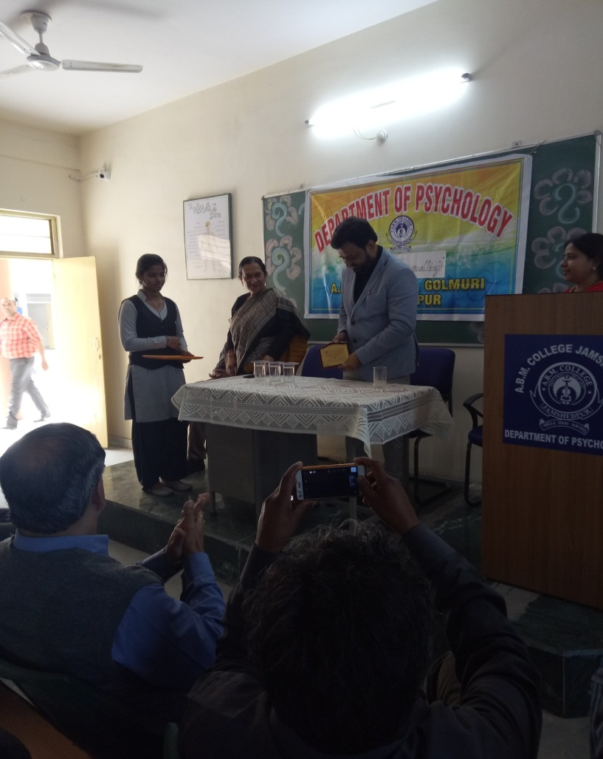
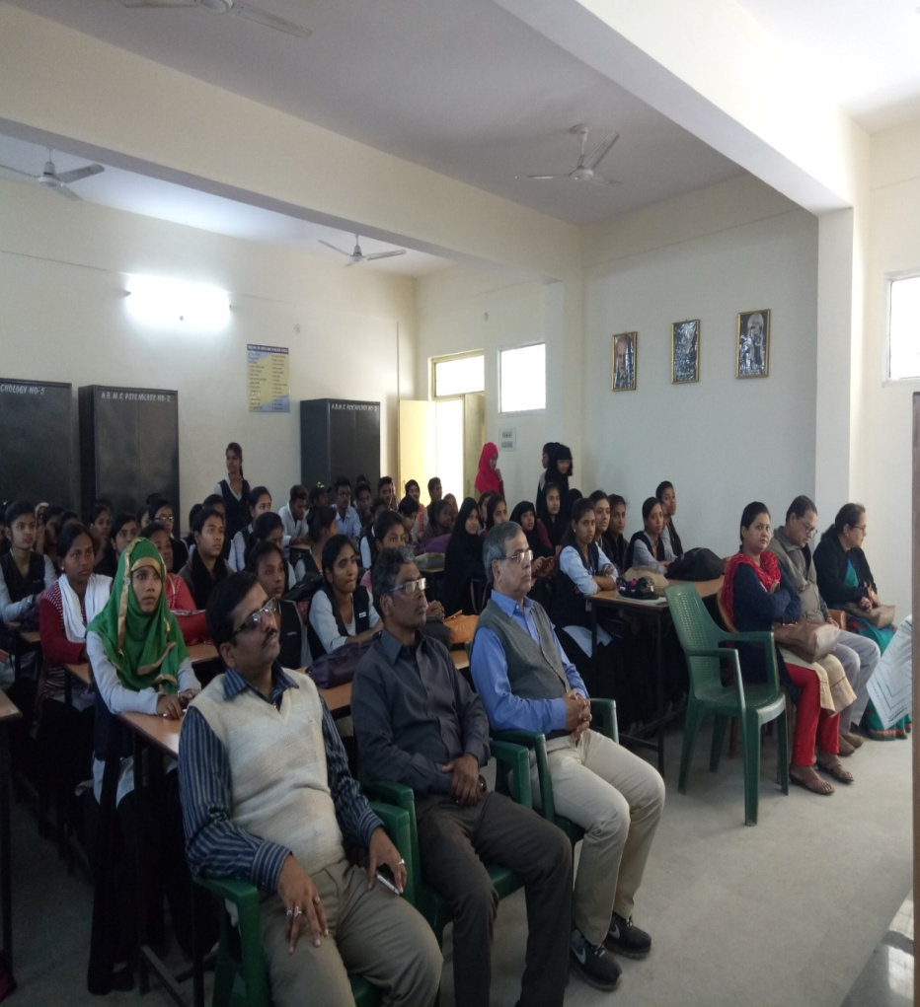
COUNSELLING PROGRAM

Slide 22
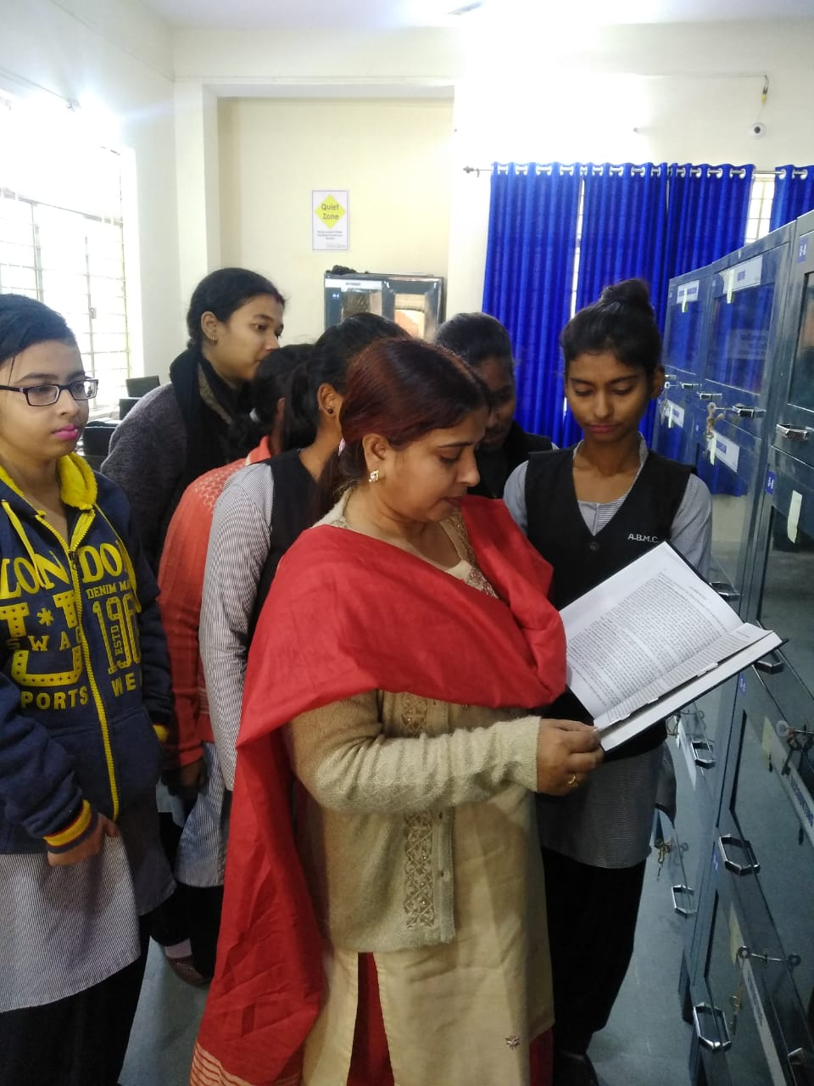
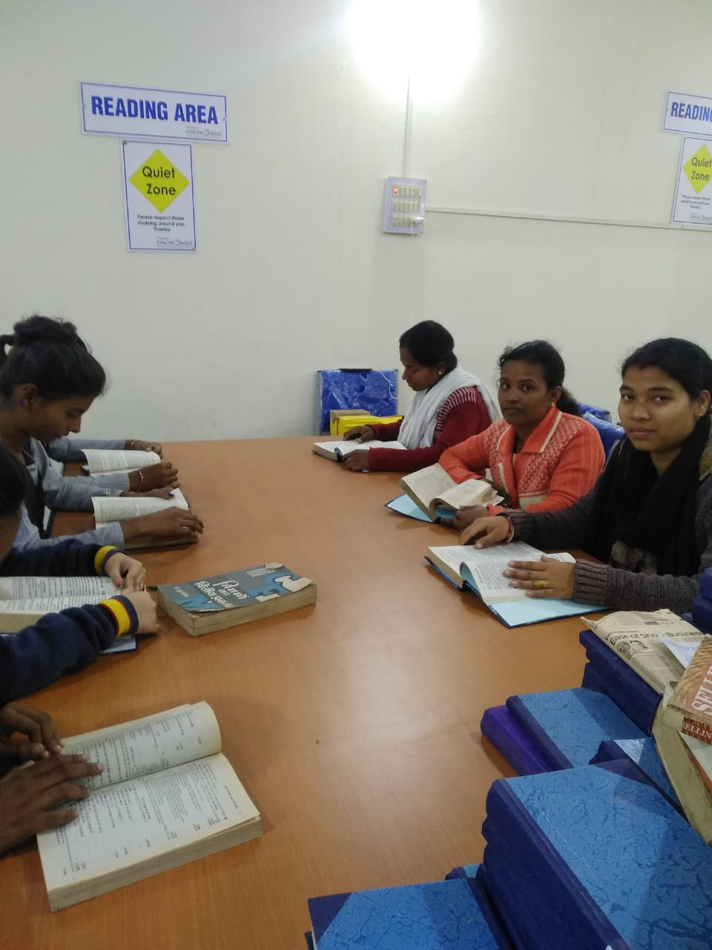
Library facilities

Slide 23
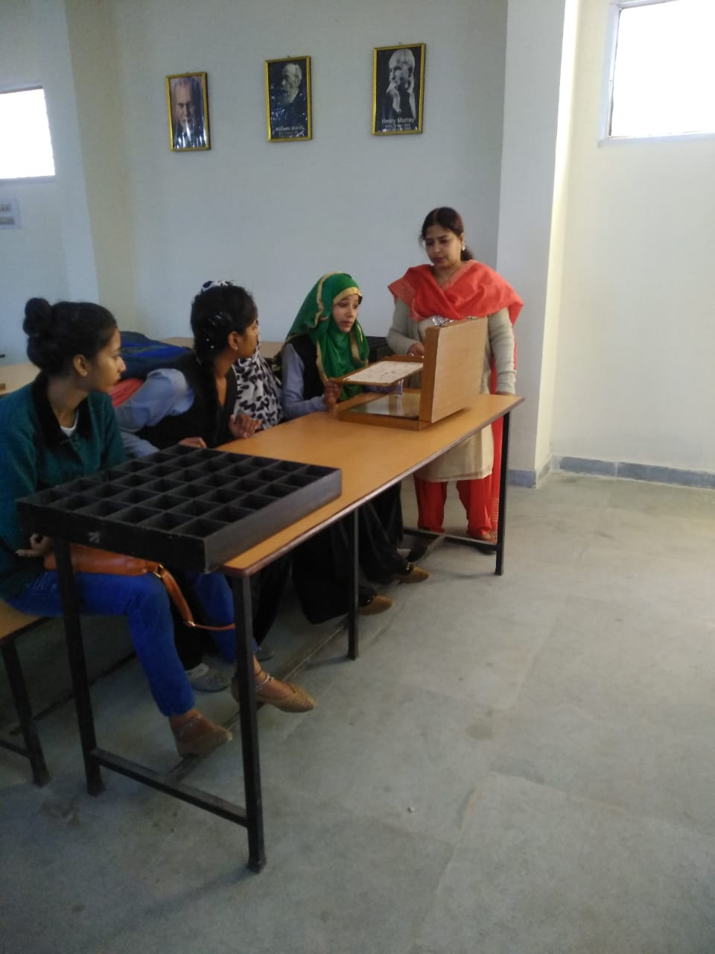
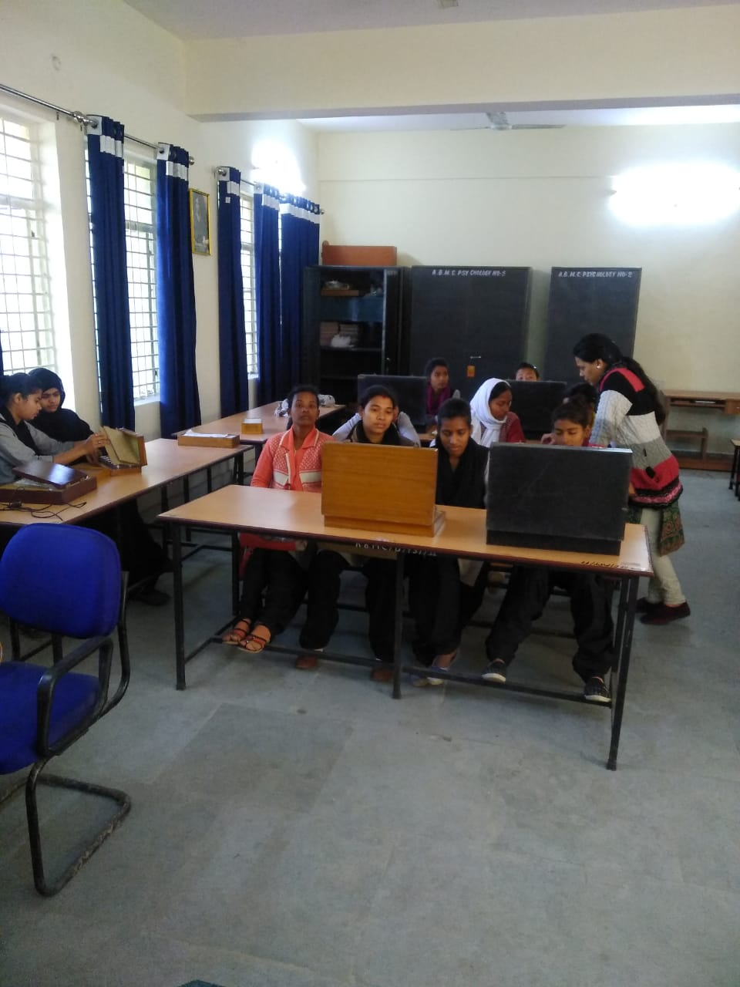
Practical Classes

Slide 24
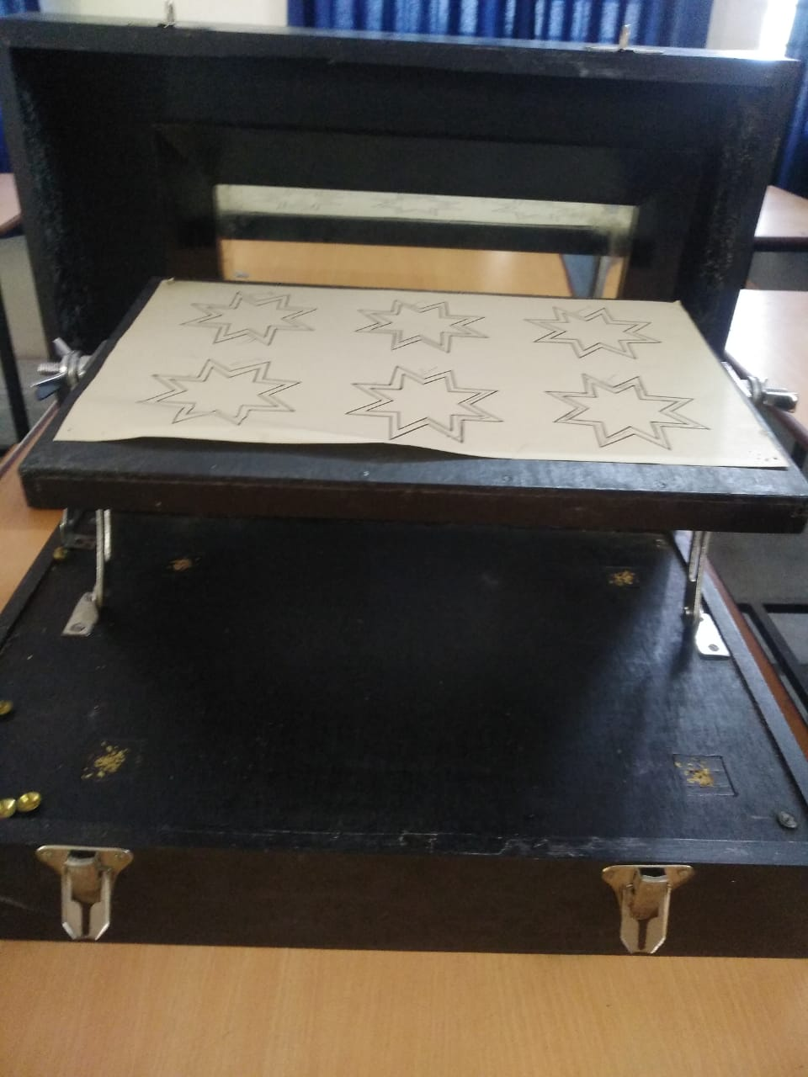
Practical Apparatus(Experiment)
MIRROR DRAWING STAR PATTERN PAPER

Slide 25
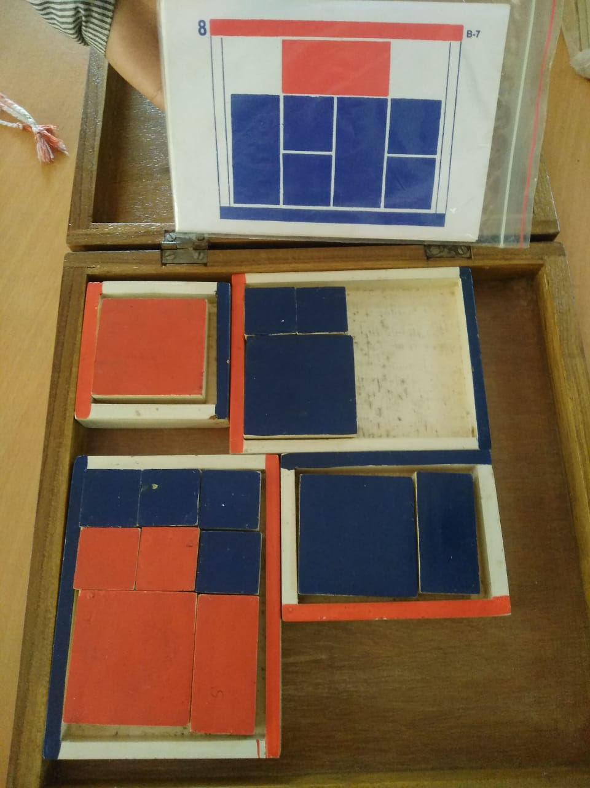
Practical Apparatus(Experiment)
PASS ALONG

Slide 26
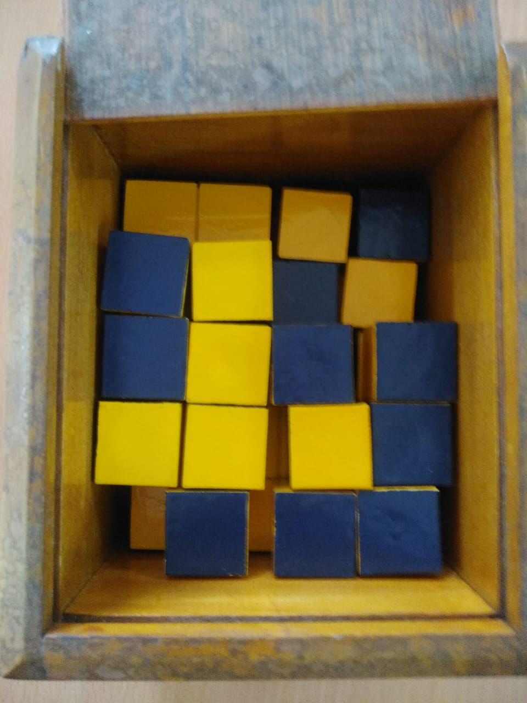
Practical Apparatus(Experiment)
BLOCK DESIGN TEST

Slide 27
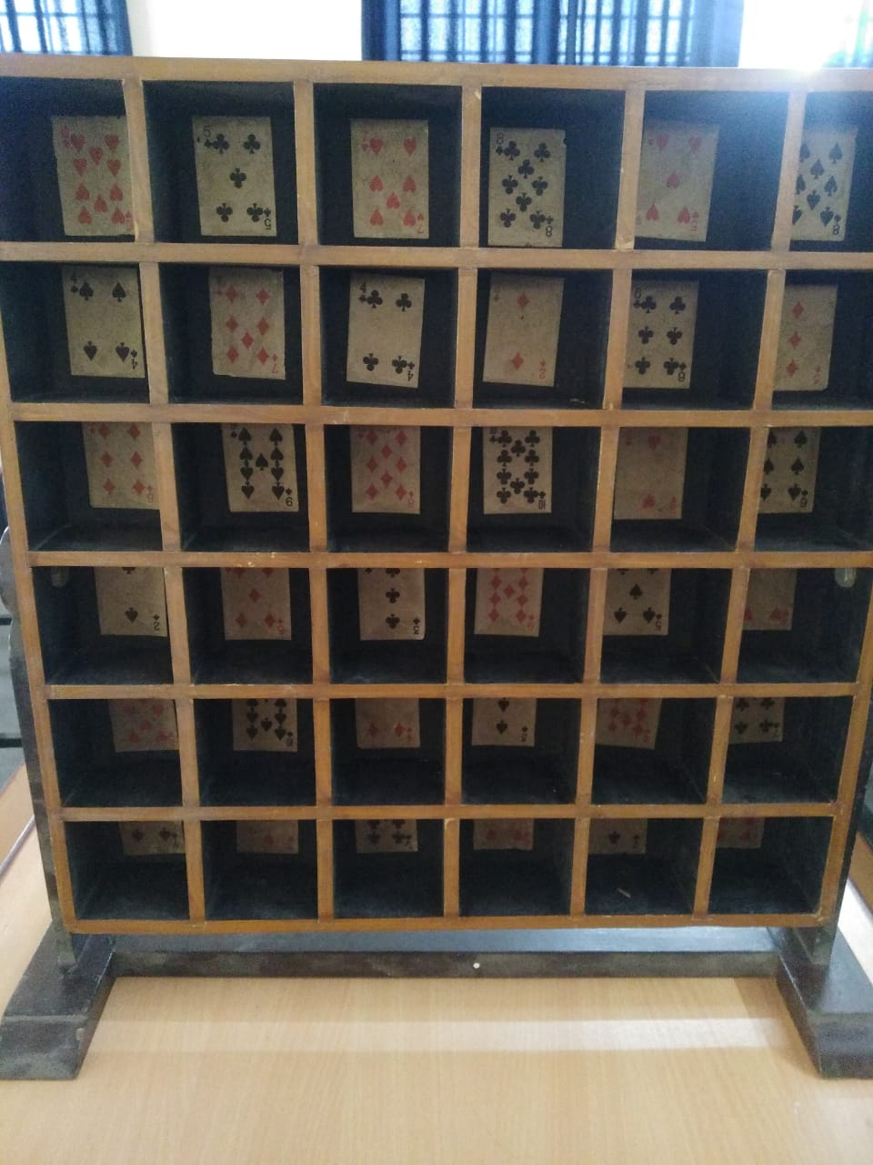
Practical Apparatus(Experiment)
Card sorting Experiment

Slide 28
Practical (Testing)
Mohsin’s Test of General Intelligence
Bell adjustment Inventory
Sinha Anixety Test
Word Association Test.
Eysenck Personality Test.

Slide 29
THANK YOU

