Slide 1
THE DEPARTMENT OF ODIA
WELCOMES
NAAC PEER TEAM MEMBERS
A.B.M COLLEGE, JAMSHEDPUR

Slide 2
ABOUT THE DEPARTMENT
The Odia Department was established in the year 1979. Since inception of the college, the department has imparted teaching and now does so till the UG Honors level. Kolhan Division of Jharkhand consists of three districts ,namely,East Singhbhum, West Singhbhum and Seraikela-Kharswan where the communication language of the local people is Odia. Odia language is the second official language of Jharkhand and the sixth classical language of India.

Slide 3
NAME OF THE PROGRAMME AND COURSES OFFERED UG (CBCS-RUSA)
B.A PROGRAMME (PASS COURSE)
B.A HONORS (C.C)
MIL COMMUNICATION(AECC)
GENERIC ELECTIVE (G.E)
B.A DISCIPLINE SPECIFIC ELECTIVE(D.S.E)

Slide 4
VISION
MISSION & VISION
To preserve Odia language amongst Odia speaking people residing in Jharkhand.
To spread the message “ Mother Tongue is the best way to express one's thoughts and emotions ”.
We are trying to attract more students to learn their Mother Tongue.
MISSION
To provide higher and research studies in Mother Tongue Odia.

Slide 5
NO. OF TEACHING POSTS
 | SANCTIONED | FILLED
ASSISTANT PROFESSORS | 02 | 01

Slide 6
FACULTY MEMBER | DETAILS
NAME | CAPT. (DR.) BIDHUBHUSAN BHUYAN
QUALIFICATION | M.A, Ph.D
DESIGNATION | ASST. PROFESSOR
DATE OF BIRTH | 21.12.1962
DATE OF JOINING | 27.7.1985
YEARS OF EXPERIENCE | 35 YEARS
Ph.D GUIDANCE | ONE RESEARCH SCHOLAR
REFRESHER COURSE | TWO REFRESHER COURSE(UGC)
ORIENTATION PROGRAMME | ONE(UGC) , RANCHI UNIVERSITY
NATIONAL SEMINAR | FIVE NATIONAL SEMINARS
WORKSHOP | NATIONAL WORKSHOP(25-29 SEPT 2018
ARTICLE IN REFERED JOURNAL | MORE THAN 10 ARTICLES PUBLISHED
PUBLICATION | TWO BOOKS
RESEARCH | COMPLETED ONE MINOR RESEARCH PROJECT SPONSORED NY UGC.
CONTACT | EMAIL : bbbhuyan.jsr123@gmail.com NO. : 9431348454

Slide 7
TEACHING LEARNING METHOD
CLASS ROOM LECTURES
TUTORIAL CLASSES
LIBRARY CLASSES
INTERACTIVE SESSIONS
PROJECT WORKS

Slide 8
WEEKLY WORKLOAD
TEACHER | TOTAL LECTURES/WEEK
CAPT.(DR.) BIDHUBHUSAN BHUYAN | 22

Slide 9
STUDENTS STATISTICS
SESSION | GEN | SC | ST | OBC | TOTAL
2013-2014 | - | - | - | - | 04
2014-2015 | - | - | - | - | 03
2015-2016 | - | - | - | - | 04
2016-2017 | - | - | - | - | 01
2017-2018 | - | - | - | - | 01

Slide 10
STUDENTS SUCCESS RATE
SESSION | APPEARED | PASSED
2013-2014 | 04 | 04
2014-2015 | 03 | 03
2015-2016 | 04 | 04
2016-2017 | 01 | 01
2017-2018 | 01 | 01

Slide 11
SPECIAL FEATURES OF THE DEPARTMENT
ACADEMIC PLANNER
MODULAR SYLLABUS
MENTORING
COUNSELLING - ACADEMIC AND PERSONAL
PARENTS TEACHER MEETING

Slide 12
ACADEMIC ACTIVITIES ORGANISED BY THE DEPARTMENT
SESSION | TOPIC
2013-2014 | SEMINAR ON “ LITERATURE AND CREATIVITY”
2014-2015
2015-2016 | SEMINAR ON “ ODIA UPANYAS RA SAMAKALINA SAMAJ CHITRA” SEMINAR ON “ PRATICAL ASPECT OF ODIA SANTH LITERATURE”
2016-2017 | SEMINAR ON “ KATHAKAAR FAKIR MOHAN SENAPATHY ” SEMINAR ON “ SPECIAL FEATURE OF ODIA LANGUAGE ” SEMINAR ON “ ODIA AS A CLASSICAL LANGUAGE “
2017-2018 | SEMINAR ON “ REETI KAVI UPENDRA BHANJ ” SEMINAR ON “ KAVIVAR RADHANATH RAY ” SEMINAR ON “ ADIKAVI SARALA DAS “

Slide 13
INFRASTRUCTURE FACILITIES
The classes are held in well lit , ventilated and smart class equipped classrooms.
Proper furniture is provided to ensure no difficulty lies with the students.
Smart class aids are used often to facilitate easy and fun learning for the students.

Slide 14
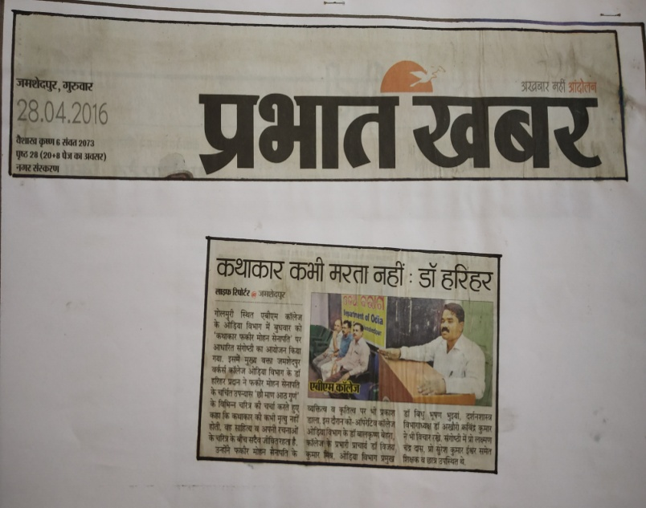
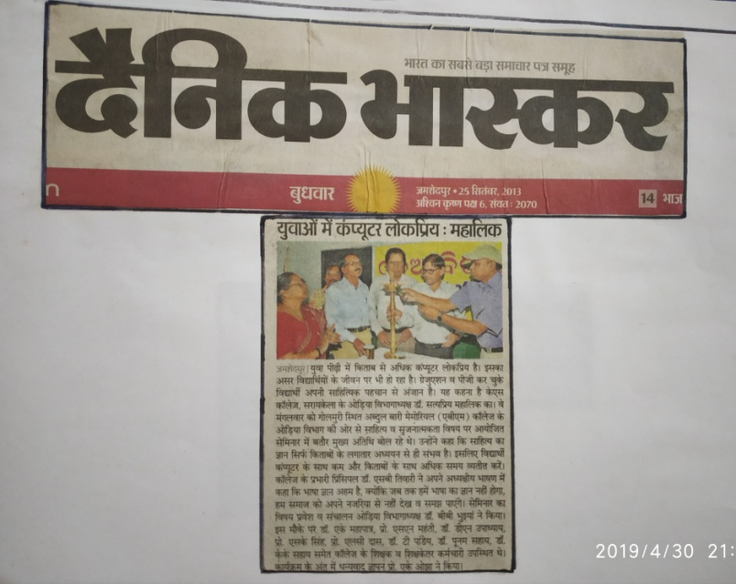
DEPARTMENTAL ACTIVITIES

Slide 15
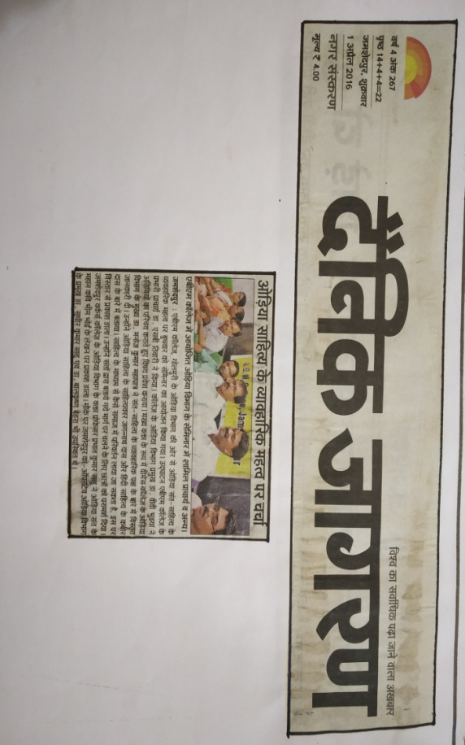
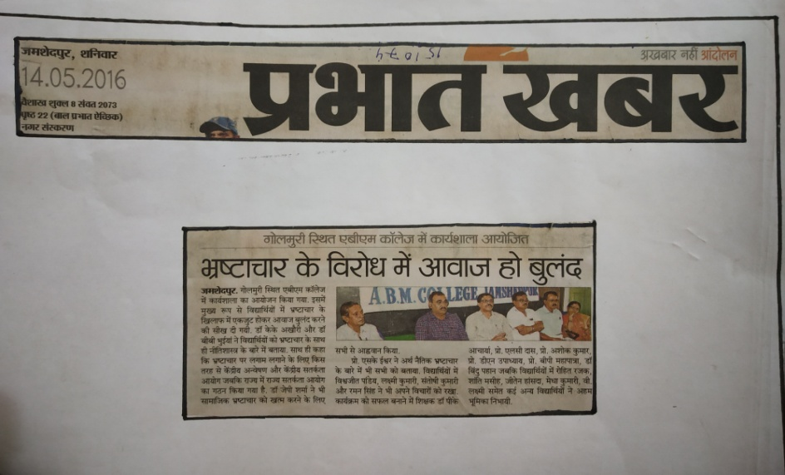
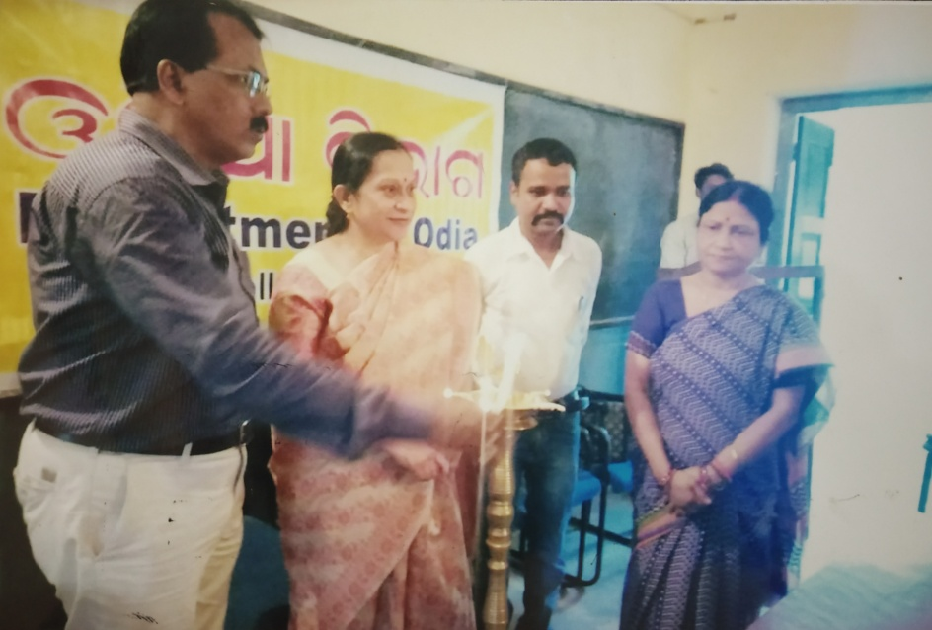
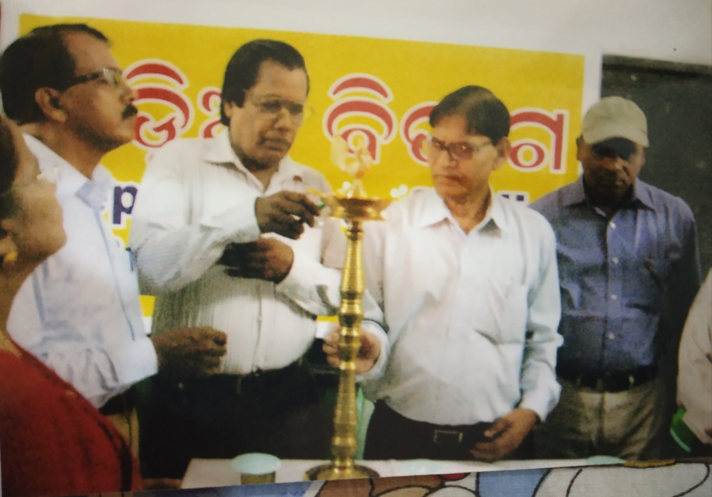
DEPARTMENTAL ACTIVITIES CONTD..

Slide 16
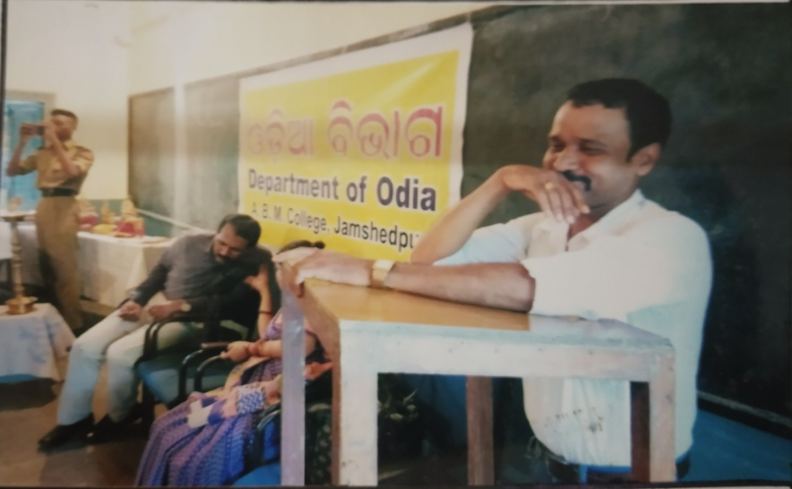
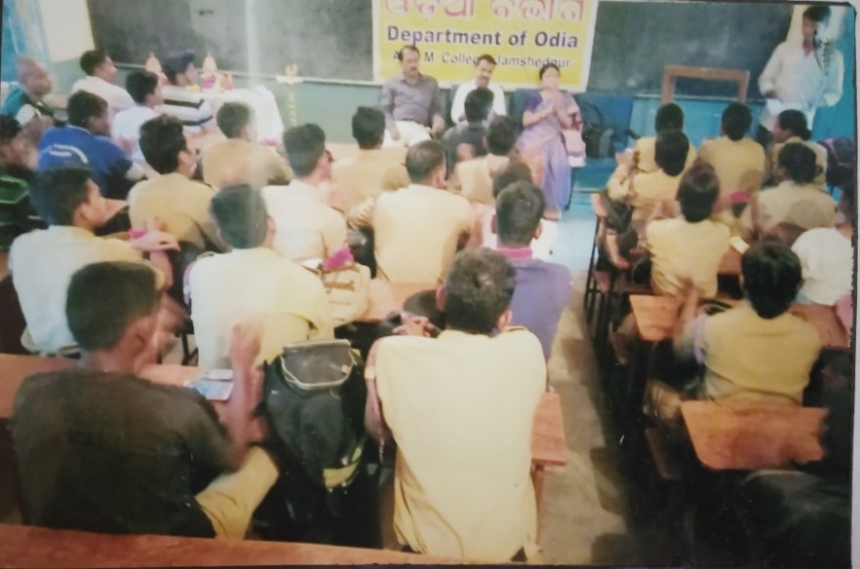
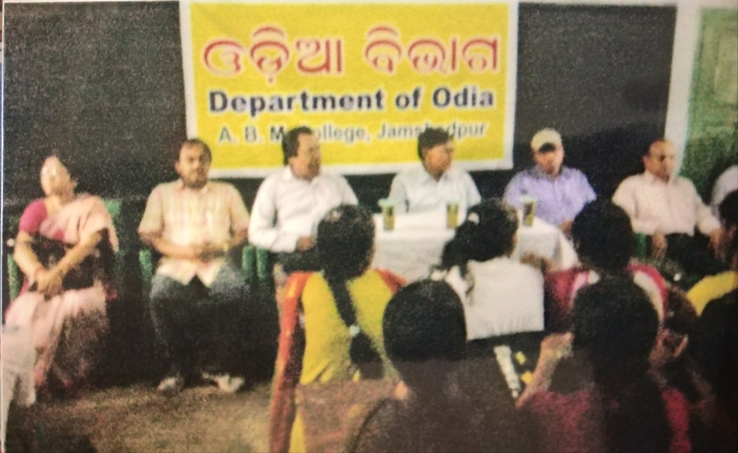
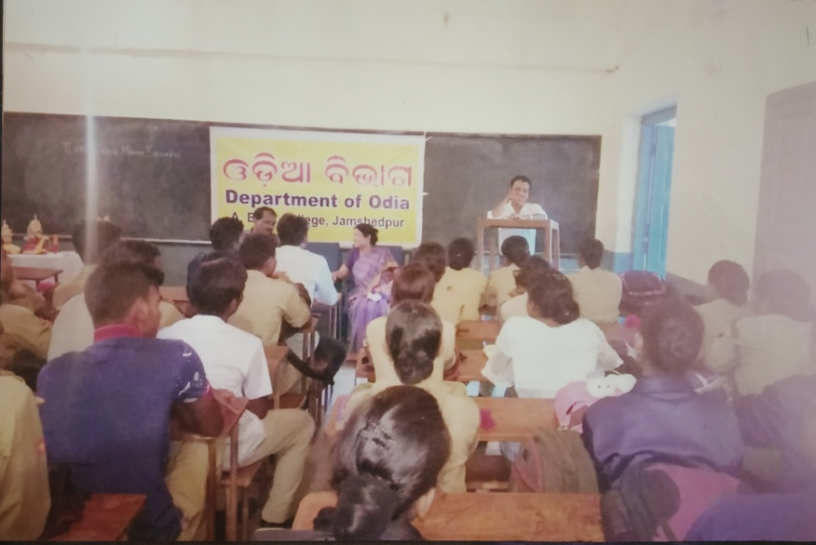
DEPARTMENTAL ACTIVITIES CONTD..

