Slide 1
Hearty Welcome
to the
NAAC PEER TEAM MEMBERS
BY
THE DEPARTMENT OF COMMERCE
A.B.M. college
GOLMURI,JAMSHEDPUR

Slide 2
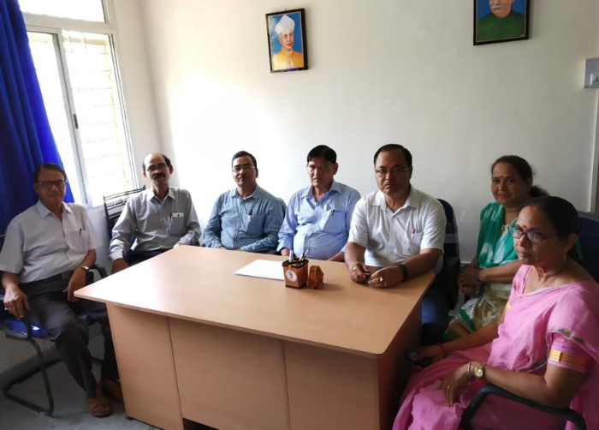
FACULTY MEMBERS:
Dr. Shashi Bhushan Tiwary (H.O.D)
Dr. Vijay Kumar Mishra
Dr. Brajendra nath Ojha
Dr. Jay Prakash Narayan
Mr. Dhirendra Dwivedi
Dr. A. Lata
Dr. Meena

Slide 3
DEPARTMENT OF COMMERCE
YEAR OF ESTABLISHMENT:
General Course: 1979
Honours Course: 1979
PG Course: 2009
NAME OF THE PROGRAMME & COURSES OFFERED:
UG ( Honours &General),
2. PG (Accounts, Finance, H.R.M. & Marketing)

Slide 4
Thrust Areas of the Department:
Financial Accounting /Corporate Accounting/Cost and Management Accounting
Business Laws/Corporate Laws/Income Tax Law and Practice
Auditing &Corporate Governance
Management Principles &Application
Business Mathematics & Statistics
Computer Application in Business
Human Resource Management/ Financial Management/Strategic Management
Goods & Service Tax

Slide 5
Thrust Areas of the Department:
Principles of Marketing /Service Marketing/ International Marketing & Marketing Research
Banking and Insurance
E-Commerce
Accounting for Managerial Decisions
Managerial Economics
Corporate Legal Framework
Business Environment
Quantitative Techniques for Business Decisions
Security Analysis and Portfolio Management

Slide 6
No. of
Assistant Professor: 5
Assistant Professor (Contractual): 2

Slide 7
OUR VISION
Creating professionals with knowledge, integrity and humanity.

Slide 8
OUR MISSION
We strive to instill a sense of willingness to acquire knowledge to grow and become honest and hard working professionals and entrepreneurs to build a new India.
To give utmost importance to the socially, economically marginalized sections of students
To prepare student in such a way, when leaving college after completion of the three-year degree course/two years Master course, he/she is equipped with a positive frame of mind, has basic communication skills, should have acquired the ability to explain something logically, and above all, should have developed a balanced personality.

Slide 9
FACULTY STATISTICS

Slide 10
FACULTY STATISTICS Cont.

Slide 11
FACULTY STATISTICS Cont. (NO. OF 1St SEM STUDENTS AND TEACHERS, 2018-19)
PG LEVEL
UG LEVEL

Slide 12
PROFILE OF THE FACULTY MEMBERS

Slide 13
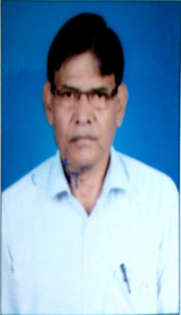
Qualification: M.Com, Ph.D Designation: Assistant Professor Date of Joining: 15/07/1980 Administrative Post held : Prof. in Charge(4+ Yrs) Ex. Member Academic Council(K.U) Member BOARD OF STUDIES, COMMERCE AND MANAGEMENT K.U Research Experience: Member, PGRC,K.U Refresher(R)/ Orientation (O) Course: R:02 Workshop Attended:03(KU:02, HRD:01) Ph.D Guidance: Awarded:01; Submitted:01 Seminar/Workshop: 18 Publication: 32 Email: (shashitiwary2011@gmail.com) Contact No.:9334240746
Dr. S.B Tiwary
(H.O.D. Commerce)

Slide 14
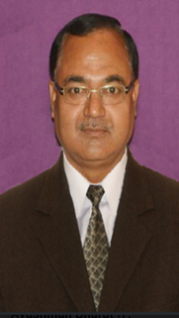
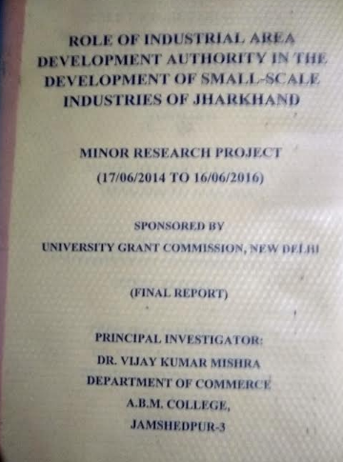
Qualification: M.Com, LLB, Ph.D Designation: Assistant Professor Date of Joining: 03/01/1983 Administrative Post HELD : Founder Finance Officer, K.U. CHAIBASA. Research Experience: Minor Research Project(UGC) Refresher(R)/ Orientation (O) Course: R:03, O:01 Ph.D Guidance: Awarded:03, Submitted:01 Seminar/ Workshop: 13 Publication: 11 Awards/Recognition: 02 Email: (vkm5860@gmail.com) Contact No.: 9835193269
Dr. V. K. Mishra

Slide 15
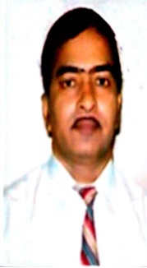
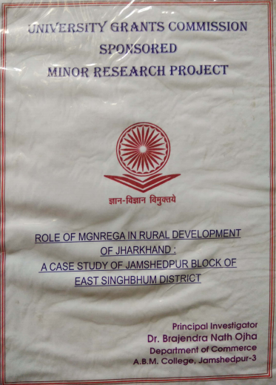
Qualification: M.Com, Ph.D Designation: Assistant Professor Date of Joining: 01/07/1983 Research Experience: Minor Research Project(UGC) Refresher(R)/ Orientation (O) Course: , R:03, O:01 Workshop Attended:03(KU:02, HRD:01) Ph.D Guidance: Submitted:01 Seminar/Workshop: 13 Publication: 14 Email: (bnojha59@gmail.com) Contact No.: 9431149854
Dr.B.N.Ojha

Slide 16
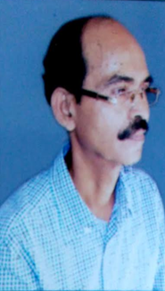
Qualification: M.Com, Ph.D Designation: Assistant Professor Date of Joining: 02/09/1985 Seminar/Workshop: 02 Publication: 04 Email: (jp.narayan@gmail.com) Contact No.:9431183687
Dr. J.P.Narayan

Slide 17
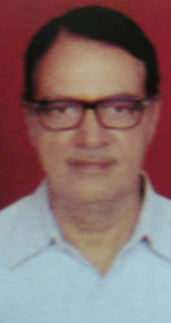
Qualification: M.Com Designation: Assistant Professor Date of Joining: 04/10/1985 Refresher(R)/ Orientation (O) Course: R:02, O:01 Seminar/Workshop: 02 Publication: 02 Email: (ddjsr.59@gmail.com) Contact No.: 9431340173
Mr. D. Dwivedi

Slide 18
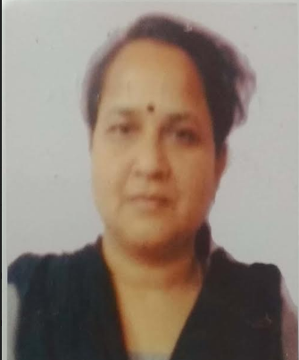
Qualification: M.Com, MBA, Ph.D Designation: Assistant Professor Date of Joining: 07Th May 2018 Seminar/Workshop: 01 Email: (lataappalla@gmail.com) Contact No.:9470315503
Dr. A. lata

Slide 19
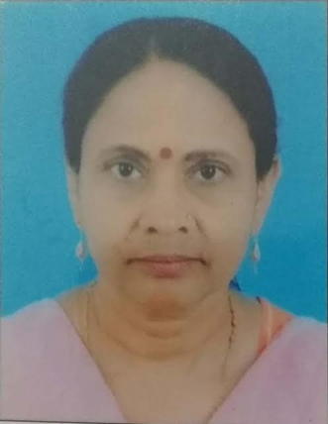
Qualification: M.Com, LLB. Ph.D Designation: Assistant Professor Date of Joining:04Th May 2018 Seminar/Workshop: 04(S)/02(W) Email: (meenkumari2k11@gmail.com) Contact No.:9471574191
Dr. Meena Kumari

Slide 20
RESEARCH OUTPUT

Slide 21
TEACHING LEARNING METHODS
CLASS ROOM LECTURES
TUTORIAL CLASSES
INTERACTIVE SESSIONS
SEMINARS
PROJECT WORKS

Slide 22
STUDENTS FROFILE admission to honours & General course
 |  | Honours |  |  | General
Sl.No | Year | Female | Male | Total | Female | Male | Total
1 | 2018-19 | 105 | 198 | 303 | 30 | 59 | 89
2 | 2017-18 | 180 | 235 | 415 | 44 | 84 | 128
3 | 2016-17 | 81 | 190 | 271 | 20 | 56 | 76
4 | 2015-16 | 125 | 345 | 470 | 04 | 52 | 56
5 | 2014-15 | 134 | 366 | 500 | 10 | 60 | 70

Slide 23
STUDENTS FROFILE admission to M.Com
Sl.No | Year | Female | Male | Total
1 | 2018-19 | 105 | 90 | 195
2 | 2017-18 | 70 | 80 | 150
3 | 2016-17 | 90 | 62 | 152
4 | 2015-16 | 196 | 106 | 302
5 | 2014-15 | 117 | 74 | 191

Slide 24
STUDENTS’ SUCCESS RATE B.Com(Hons)
Sl. No | Year | Total Appeared | Total Passed | % of Success | 1ST | 2ND
1 | 2014 | 219 | 198 | 90.41 | 44 | 154
2 | 2015 | 309 | 275 | 88.99 | 48 | 227
3 | 2016 | 224 | 186 | 83.04 | 40 | 146
4 | 2017 | 242 | 218 | 90.08 | 83 | 135
5 | 2018 | 295 | 226 | 76.61 | 44 | 182

Slide 25
STUDENTS’ SUCCESS RATE B.Com(General)
Sl. No | Year | Total Appeared | Total Passed | % of Success | 1ST | 2ND | 3RD
1 | 2014 | 42 | 41 | 97.62 | 3 | 26 | 12
2 | 2015 | 27 | 24 | 88.89 | 0 | 11 | 13
3 | 2016 | 25 | 18 | 72.00 | 0 | 16 | 2
4 | 2017 | 21 | 17 | 68.00 | 0 | 12 | 5
5 | 2018 | 26 | 24 | 92.31 | 0 | 19 | 5

Slide 26
STUDENTS’ SUCCESS RATE M.Com
Sl. No | Year | Total Appeared | Total Passed | % of Success | 1ST | 2ND
1 | 2014 | 110 | 107 | 97.27 | 48 | 59
2 | 2015 | 123 | 121 | 98.37 | 73 | 48
3 | 2016 | 151 | 147 | 97.35 | 35 | 112
4 | 2017 | 253 | 250 | 98.81 | 239 | 11
5 | 2018 | 133 | 129 | 96.99 | 122 | 7

Slide 27
SPECIAL FEATURES OF THE DEPARTMENT
COMMITED FACULTY MEMBERS
WELL EQUIPPED COMPUTER LAB WITH AUDIO VISUAL FACILITIES
GOOD LIBRARY WITH INFLIBNET FACILITY
SMART CLASS

Slide 28
ACADEMIC ACTIVITIES OF THE DEPARTMENT
Seminars Organised by the Department
YEAR | TOPIC | SPEAKER
2000 | Employer and employee relationship (State Level) | Dr. N.K.Singh (Ex. Dean Ranchi University Ranchi)
2015 | Importance of Commerce Education in Today's Context | Dr. D.K. Mitra,(P. G. Department of Commerce and Business management, Kolhan University Chaibasa)
2016 | Role of RBI in Indian Economy | Dr. D.K. Pandey, (Department of commerce and Business management, Womens college. Kolhan University Chaibas
2016 | Prospect of E-Commerce in India | Dr. A.K. Mehta, (Head Department of commerce, Workers College, Jamshedpur, Kolhan University Chaibasa)
2016 | Business Leadership In Present Scenario | Dr. P.K. Pani (Controller of Examinations, Kolhan University Chaibasa)
2017 | Problem and prospects of cashless transaction in indian economy | Dr. D.K. Mitra,(P. G. Department of Commerce and Business management, Kolhan University Chaibasa)
2017 | Stock Exchange and Indian Economy | Dr. A.K. Mehta (Head Department of commerce, Workers College, Jamshedpur, Kolhan University, Chaibasa)
2019 | Provisions of Indian Companies Act 2013 | Dr. S. B . Tiwary , Dr. V.K. Mishra , Dr. B.N. Ojha, Dr. J.P. Narayan and Mr. D. Dwevdi. Dr. Alata and Dr. Meena
2019 | GST- Goods and Services Tax | Dr. Mudita Chandra, Dr. S. B . Tiwary , Dr. V.K. Mishra , Dr. B.N. Ojha, Dr. J.P. Narayan and Mr. D. Dwevdi. Dr. Alata , and Dr. Meena

Slide 29
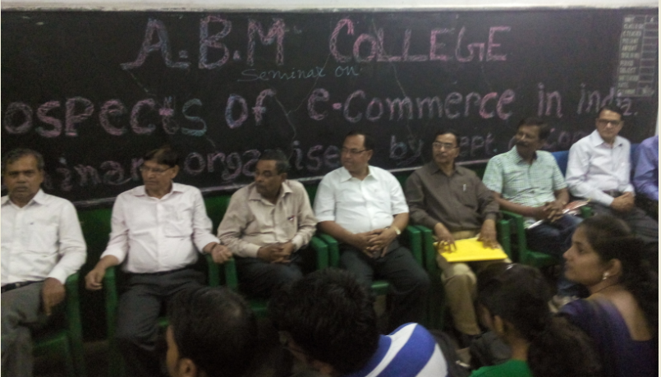
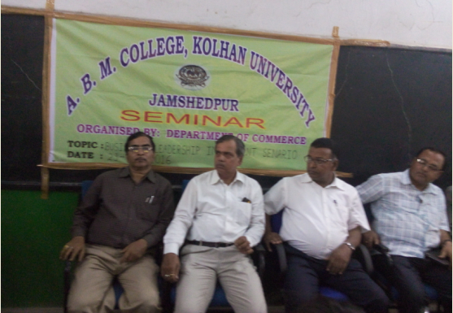
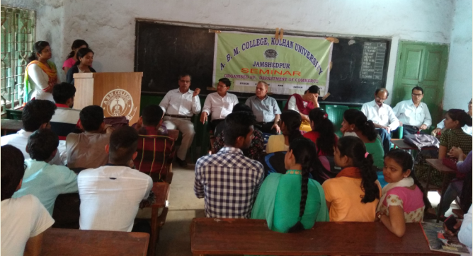
ACADEMIC ACTIVITIES OF THE DEPT. Cont.
Seminars – Few Snapshots

Slide 30
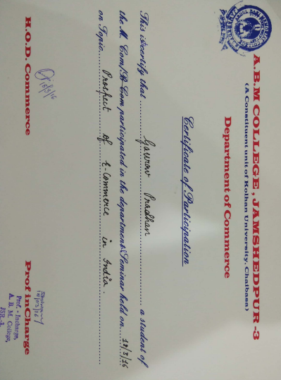
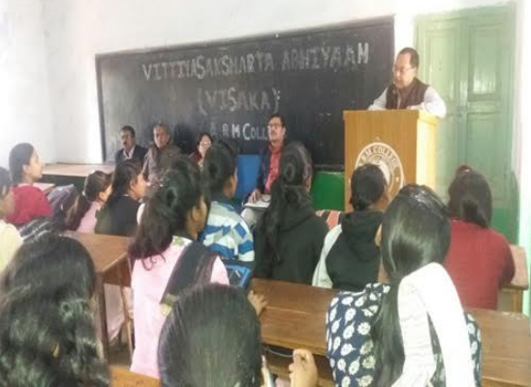
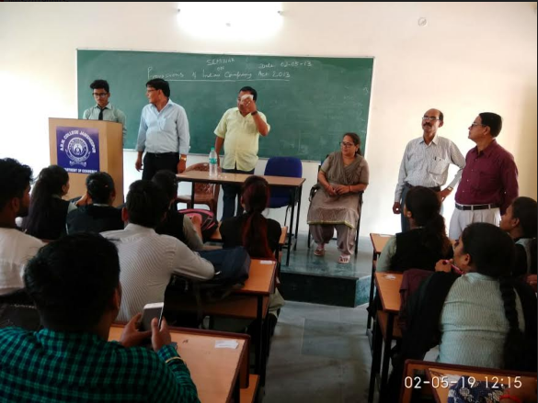
ACADEMIC ACTIVITIES OF THE DEPT. Cont.
Seminars – Few Snapshots

Slide 31
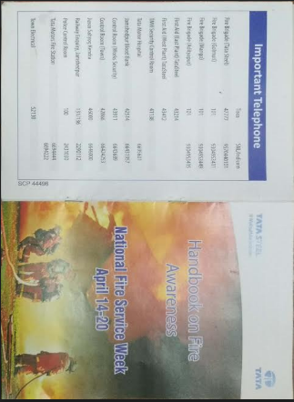
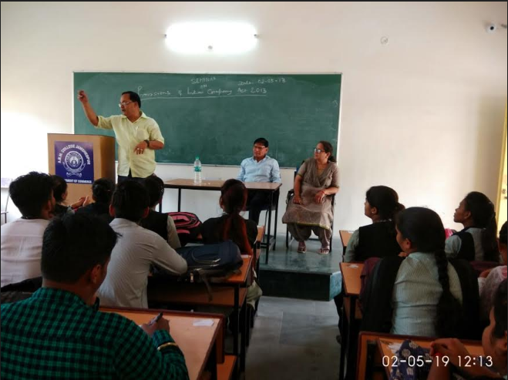
ACADEMIC ACTIVITIES OF THE DEPT. Cont.
Seminars – Few Snapshots
WORKSHOP

Slide 32
SWOC
S: STRENGTH
W:WEAKNESS
O: OPPORTUNITIES
C: CHALLANGES

Slide 33
S: STRENGTH
We at ABM college are proud of quite a few things. Firstly we must talk about our faculty. We are truly proud of our faculty that boosts of not only nearly all Doctorates but also majority of the members have produced Ph.Ds. They also submitted minor research projects sponsored by the UGC. The next thing that comes to mind are the regular classes that are held in the department. Organizing Departmental seminars and talks being part of the regular activities is definitely a part of our strength.

Slide 34
W:WEAKNESS
The student strength of Commerce Department is quite large. Since some of our faculty members have been transferred to other colleges and P.G. Departments of Kolhan University, a shortage that needs to be filled.

Slide 35
O: OPPORTUNITIES
Given more hands the department with the enthusiasm of the students, we has the capability of becoming the best commerce department not only in the university but also in the state.

Slide 36
C: CHALLANGES
Faculty members being transferred randomly is creating a gap to the Department. Introduction of E-Classes, computer based teaching and online teaching facilities.

Slide 37
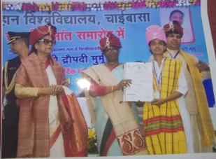
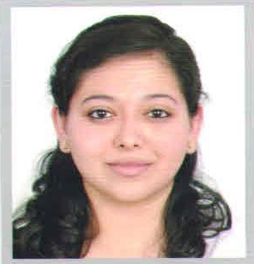
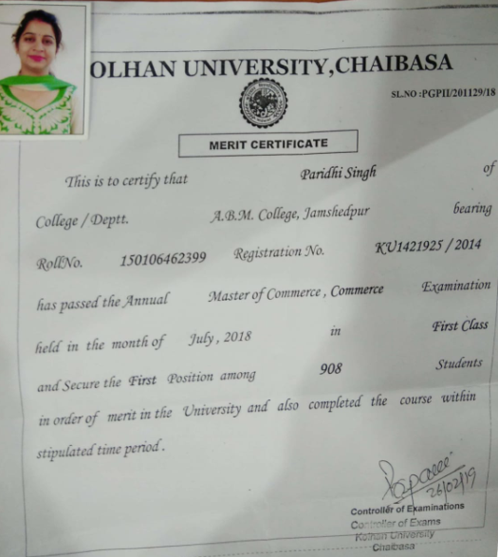
OUR PRIDE
SWATI KUMARI
2014-2017
Roll No. 150105435794
B.COM(HONS) UNIVERSITY TOPPER
RUPSHA ACHARYA
M.COM
2014-16
Fellow Program (XLRI)
PARIDHI SINGH
2016-2018
Reg.No. KU1421925/2014
M.COM UNIVERSITY TOPPER

Slide 38
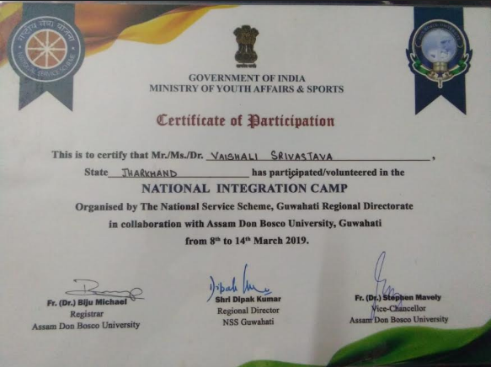
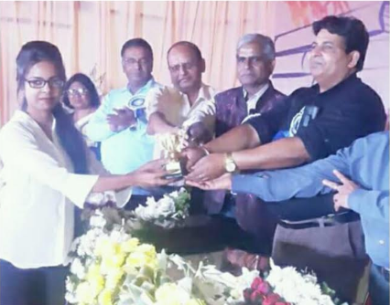
OUR PRIDE
VAISHALI SRIVASTAVA
B.COM SEM IV
2017-20

