Slide 1
Hearty Welcome
to the
NAAC PEER TEAM MEMBERS
BY
THE DEPARTMENT OF SOCIOLOGY
A.B.M. college
GOLMURI,JAMSHEDPUR

Slide 2
CONTENTS:
About Department
Vision
Mission
Faculty Statistics
Research Experience
Research Output
Achievements
Learning Methods
Students’ Profile
Success Rate
Academic Activities
Extra Curricular Activities
Infrastructure
Membership
SWOC

Slide 3
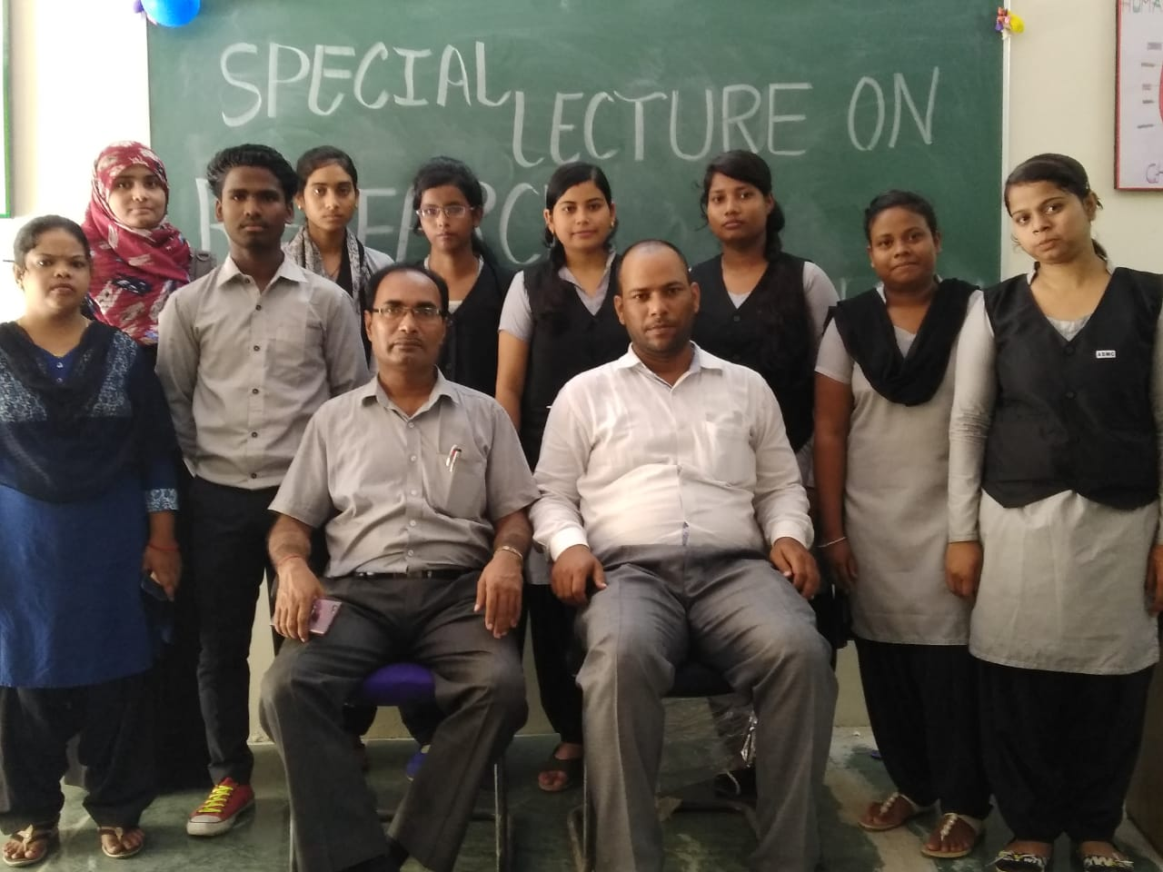
Departmental Presentation by:
Dr. Sanjay kumar Jha
Dr. Utpal kumar chakraborty

Slide 4
DEPARTMENT OF SOCIOLOGY
YEAR OF ESTABLISHMENT:
General Course: 1981
Honours Course: 1981
NAME OF THE PROGRAMM & COURSES OFFERED: UG ( Honours &General)

Slide 5
Thrust Areas of the Department:
Introduction of Sociology
Indian Society and Change
Social Research and Methods
Pioneers of Social Thinkers
Social problems in India
Urban Sociology
Rural Sociology
Sociology of Tribes
Industrial Sociology
Social Anthropology
Indian Social Thinkers
Sociology of Development and Change
Labour and Social Welfare
Social Psychology
Sociology of Religion
Social Movements in India
Globalisation and Society

Slide 6
No. of Teaching Posts:
Assistant Professors: 2

Slide 7
OUR VISION
The vision of the Department is to move towards Excellence in Higher Education in order to Achieve a Just, Plural and Equitable Society in Consonance with the Constitutional Values.

Slide 8
OUR MISSION
To give utmost importance to the socially, economically marginalized sections of students
To preserve and enrich the already rich socio-cultural traditions of the hinterland
To prepare a student such that, when leaving college after completion of the three-year degree course, he/she is equipped with a positive frame of mind, has basic communication skills, should have acquired the ability to explain something logically, and above all, should have developed a balanced personality.

Slide 9
OUR MISSION
To give utmost importance to the socially, economically marginalized sections of students
To preserve and enrich the already rich socio-cultural traditions of the hinterland
To prepare a student such that, when leaving college after completion of the three-year degree course, he/she is equipped with a positive frame of mind, has basic communication skills, should have acquired the ability to explain something logically, and above all, should have developed a balanced personality.

Slide 10
FACULTY STATISTICS

Slide 11
FACULTY STATISTICS Cont.

Slide 12
FACULTY STATISTICS Cont.

Slide 13
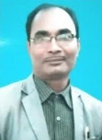
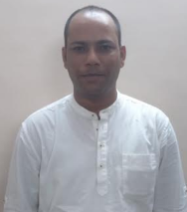
FACULTY STATISTICS Cont.
Name | Qualification | Designation | Years of Experience
Dr. Sanjay Kumar Jha | M.A., Ph.D. | Assistant Professor (Contractual) | 2
Dr.Utpal Kumar Chakraborty | M.A., Ph.D. | Assistant Professor (Contractual) | 6

Slide 14
FACULTY STATISTICS Cont. Distribution of Honours and General classes
Teacher | Honours Class | General Class | Total
Dr. Sanjay Kumar Jha | 19 | 5 | 24
Dr.Utpal Kumar Chakraborty | 22 | 2 | 24
Total | 41 | 7 | 48

Slide 15
FACULTY STATISTICS Cont.
Class Distribution Pattern
 |  | CC | GE | DSC | DSE | AESB | TUTORIAL
Dr. Sanjay Kumar Jha | UG SEM I & II | 3 | 0 | 2 |  |  |  | 24
 | UG SEM III & IV | 5 | 0 | 1 |  | 2 | 1
 | UG SEM V & VI | 7 |  |  | 2 |  | 1
Dr. Utpal Kumar Chakraborty | UG SEM I & II | 4 | 2 | 0 |  |  | 1 | 24
 | UG SEM III & IV | 6 | 2 | 1 |  | 0 | 0
 | UG SEM V & VI | 7 |  |  | 1 | 0

Slide 16
RESEARCH OUTPUT – PUBLICATIONS Name of the Faculty: Dr.Sanjay kumar Jha
Sl. No. | NAME OF THE PAPER/ ARTICLE | NAME OF JOURNAL / MAGAZINE | YEAR
1 | Bihar Me Garibi : Dalit Ke Vishesh Pariprekchhy me : EEk Samaj Shastriya Adhayan | Navdrishti Research Journal | 2013
2 | Adhunik Bharti Samaj me Sukhwadi Vivah : Ek Samajshastriya Adhyan | Pariprekchhy, A Research Journal of New Thoughts | 2014
3 | Impact of RTI Act on Panchayati Raj in Jharkhand, Ek Samajshastriya Adhyanan | Navdrishti Research Journal | 2014
4 | Constricted and standardised of Domestic Violence Attitude Scale : A social psychological study | Anushilana | 2015
5 | Impact of women empowerment of Dalit women in Jharkhand : A sociological analysis | Jharkhand Journal of social development | 2015
 | NAME OF THE BOOK | PUBLISHER
1 | Vikas aur Parivartan Ka Samajshastra | S.K. Publishing, Ranchi | 2013
2 | Bhartiya Paripekchhya me Manavadhikar | S.K. Publishing, Ranchi | 2016

Slide 17
RESEARCH OUTPUT – SEMINAR/WORKSHOP/TRAINING ATTENDED Name of the Faculty: Dr.Sanjay kumar Jha
International Seminar:04
National Seminar:08
Regional Seminar:01
Workshop:01
Training:01

Slide 18
RESEARCH OUTPUT – PUBLICATIONS Name of the Faculty: Dr.Utpal Kumar Chakraborty
Sl. No. | NAME OF THE PAPER/ ARTICLE | NAME OF JOURNAL /MAGAZINE | YEAR
1 | Initiatives under Corporate Social Responsibility: A Study on National Thermal Power Corporation (NTPC), of India | Jharkhand Journal of Social Development | 2014
2 | Socio-Economic Issues and Dilemmas of Mining Induced Displacement: A Case of Coal Mining Industry | Journal of Economic & Social Development | 2014
3 | Sustainable Development Initiatives under Corporate Social Responsibility: A Study on Steel Authority of India Limited (SAIL) | Asian Mirror- International Journal of Research | 2015
4 | Revisiting The Models Underpinning Corporate Social Responsibility | Asian Mirror- International Journal of Research | 2015
5 | Developments in the Concept of Corporate Social Responsibility (CSR) | The Researchers’ International Journal of Research | 2015
6 | Coupling Corporate Social Responsibility into Millennium Development Goals: A Case Study of Tata Steel Limited in Jharkhand | The Researchers’ International Journal of Research | 2016
7 | Corporate Social Responsibility for Sustainable Development of Indigenous People in Jharkhand: A Case Study of Tata Steel Limited’ | Asian Mirror- International Journal of Research | 2016

Slide 19
RESEARCH OUTPUT – PUBLICATIONS Name of the Faculty: Dr.Utpal Kumar Chakraborty
Sl. No. | NAME OF THE BOOK | NAME OF PUBLISHER | YEAR
1 | Corporate Social Responsibility and Sustainable Rural Development | Nation Press, New Delhi. | 2019
Sl. No. | CHAPTER IN EDITED VOL.. | NAME OF PUBLISHER | YEAR
1 | Shifting Perspectives in Tribal Studies “A Situational Analysis of Education Amongst the Scheduled Tribes in Jharkhand: Emphasizing Government’s Perspective & Conscientiousness”. | Springer Nature Singapore Pte Ltd. | 2019
2 | Atrocities on Tribal Women and Legal Action: Human Rights Perspective. Perspectives of Tribal Studies: Contemporary Development Issues and Concerns (Vol.V) | Serials Publications, New Delhi. | 2019
3 | Sustainable Development of Tribals and CSR. Perception of Tribal Development Volume-I | Trident Publications, New Delhi. | 2017

Slide 20
RESEARCH OUTPUT – SEMINAR/WORKSHOP/TRAINING ATTENDED Name of the Faculty: Dr.Utpal Kumar Chakraborty
International Seminar:04
National Seminar:07
Refresher course: 01
Workshop:03
Training:02

Slide 21
ACHIEVEMENTS OF FACULTY MEMBER
Name of the Faculty: Dr. Utpal Kumar Chakraborty
Sl.No | Awards, Honor, & Grants |  | Year
1 | Senior Research Fellowship | University Grants Commission | 2015
2 | Gold Medal | Ranchi University, Ranchi | 2013
3 | Junior Research Fellowship | University Grants Commission | 2012
4 | Teaching Assistantship | Ranchi University, Ranchi | 2012

Slide 22
TEACHING LEARNING METHODS
CLASS ROOM LECTURES
TUTORIAL CLASSES
LIBRARY CLASSES
INTERACTIVE SESSIONS
SEMINARS
PROJECT WORKS
EDUCATIONAL EXCURSIONS

Slide 23
STUDENTS FROFILE admission to honours course
Sl.No | Year | Female | Male | Total
1 | 2018-19 | 27 | 19 | 49
2 | 2017-18 | 23 | 22 | 45
3 | 2016-17 | 30 | 10 | 40
4 | 2015-16 | 29 | 26 | 55
5 | 2014-15 | 10 | 15 | 25
6 | 2013-14 | 08 | 06 | 14

Slide 24
STUDENTS FROFILE Cont... admission to honours course: Social Category wise
 |  | GENERAL |  | OBC |  | SC |  | ST |  | TOTAL
Sl.No | Year | Female | Male | Female | Male | Female | Male | Female | Male
1 | 2018-19 | 21 | 15 | 02 | 03 | 03 | 02 | 01 | 00 | 49
2 | 2017-18 | 21 | 22 | 01 | 00 | 01 | 00 | 00 | 00 | 45
3 | 2016-17 | 21 | 05 | 01 | 02 | 03 | 01 | 05 | 02 | 40
4 | 2015-16 | 25 | 18 | 00 | 00 | 02 | 04 | 02 | 04 | 55
5 | 2014-15 | 18 | 11 | 00 | 00 | 01 | 00 | 02 | 03 | 25
6 | 2013-14 | 05 | 04 | 00 | 00 | 02 | 02 | 01 | 00 | 14

Slide 25
STUDENTS’ SUCCESS RATE
Sl. No | Year | Total Appeared | Total Passed | % of Success
1 | 2014 | 33 | 32 | 96.33
2 | 2015 | 39 | 35 | 89.74
3 | 2016 | 21 | 19 | 90.47
4 | 2017 | 25 | 24 | 96.00
5 | 2018 | 27 | 19 | 70.37

Slide 26
ACADEMIC ACTIVITIES OF THE DEPARTMENT
1. INDUCTION CLASS
2. STUDENT SEMINAR
7. PARENT TEACHER MEET
3. GROUP DISCUSSION
4. DEBATE
6. QUESTION ANSWER SESSION
5. POSTER PRESENTATION

Slide 27
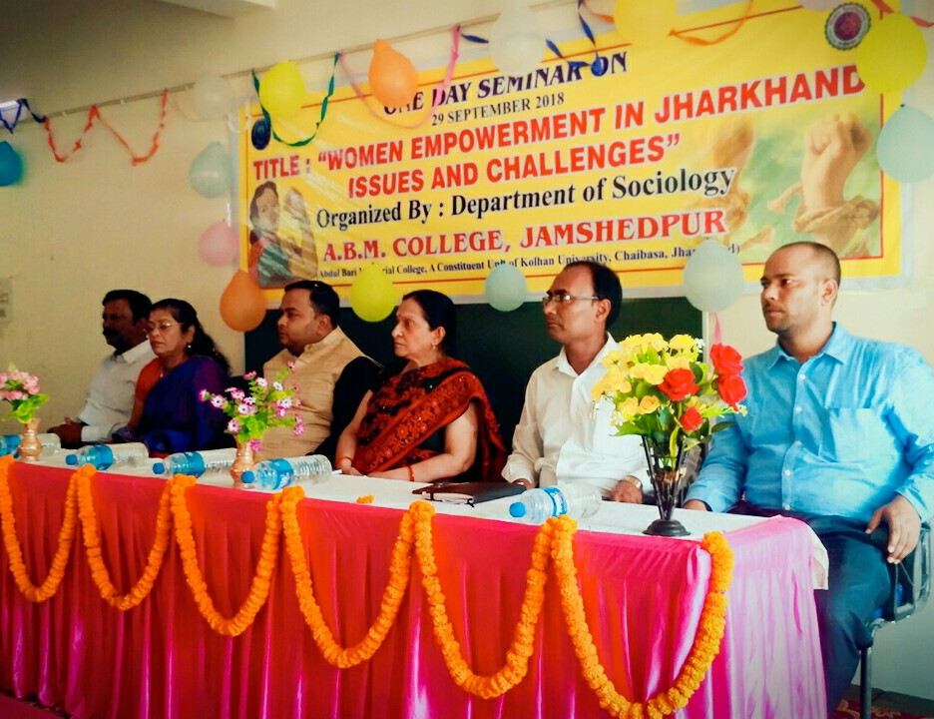
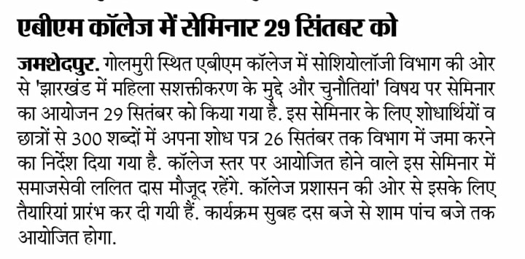
ACADEMIC ACTIVITIES OF THE DEPT. Cont.
Seminars

Slide 28
ACADEMIC ACTIVITIES OF THE DEPARTMENT
FIELD VISIT
YEAR | PLACE | SIGNIFICANCE OF THE PLACE
2018 | KARANDIH PANCHAYAT | TRIBAL VILLAGE
2019 | BAYAMVIL PANCHAYAT | TRIBAL VILLAGE

Slide 29
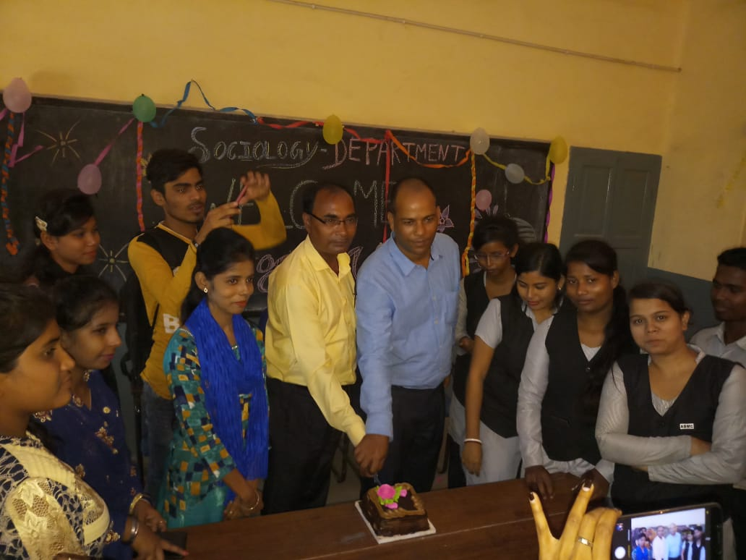
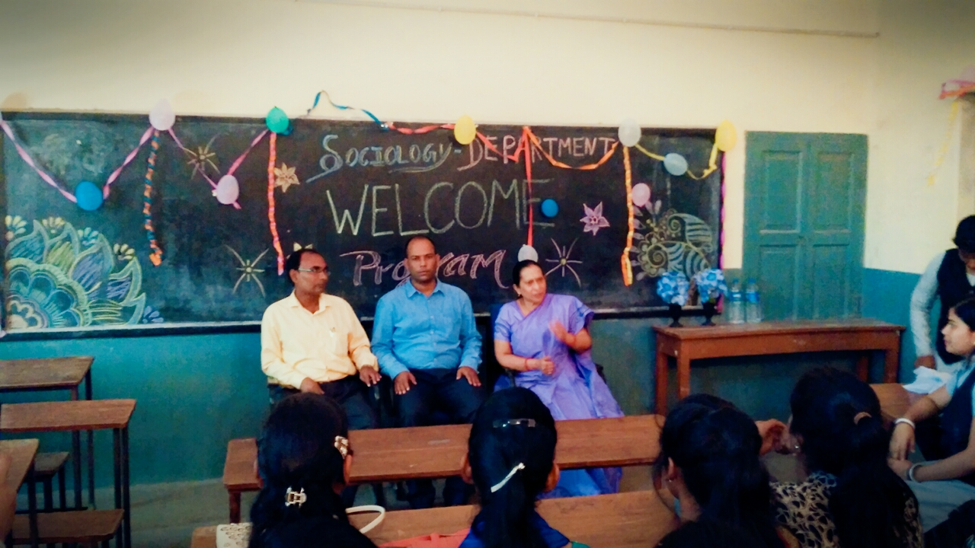
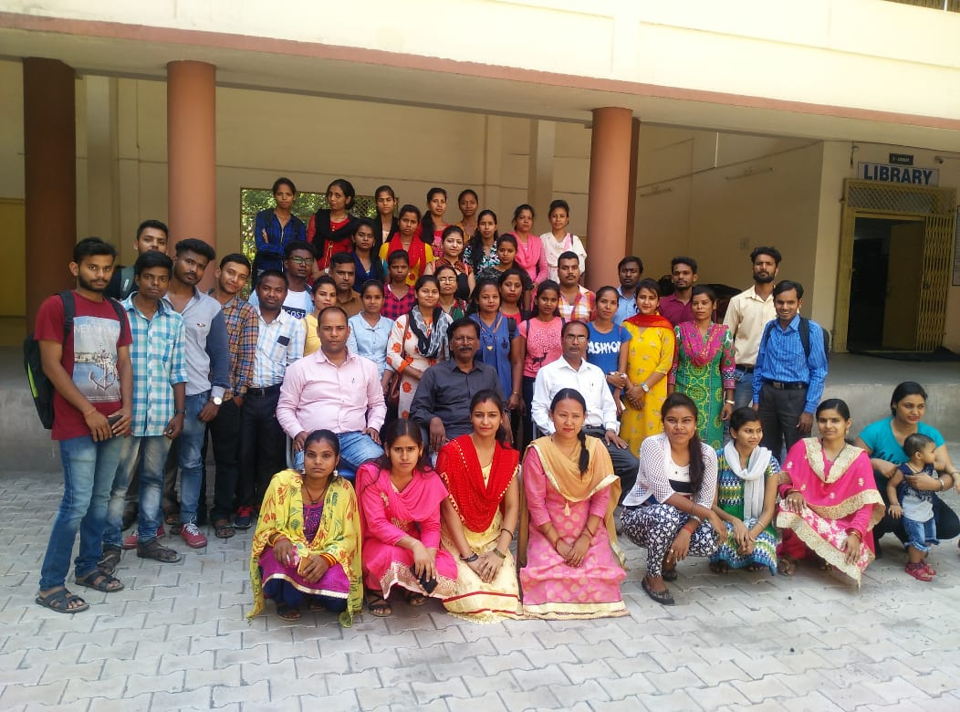
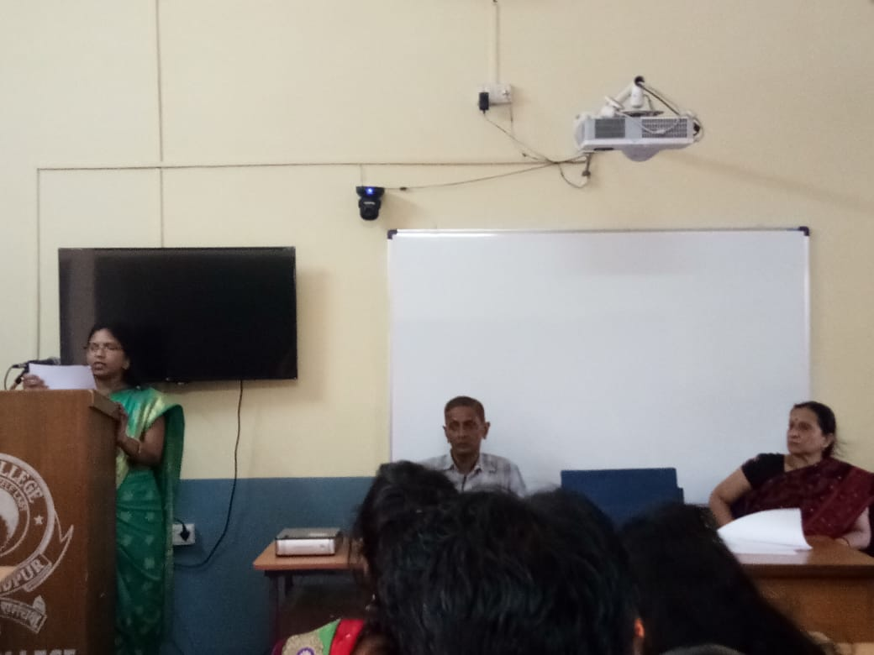
EXTRA CURRICULAR ACTIVITIES OF THE DEPARTMENT
Few Snapshots

Slide 30
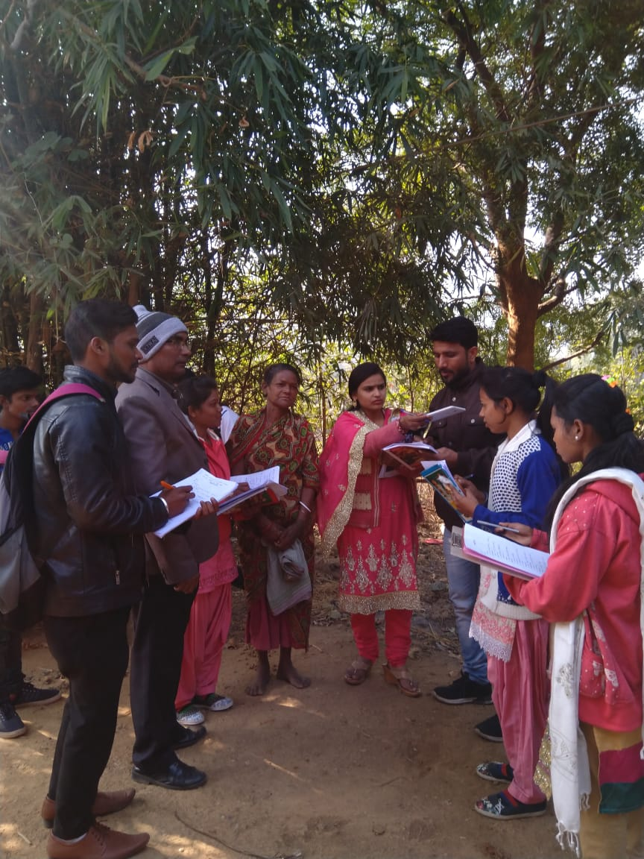
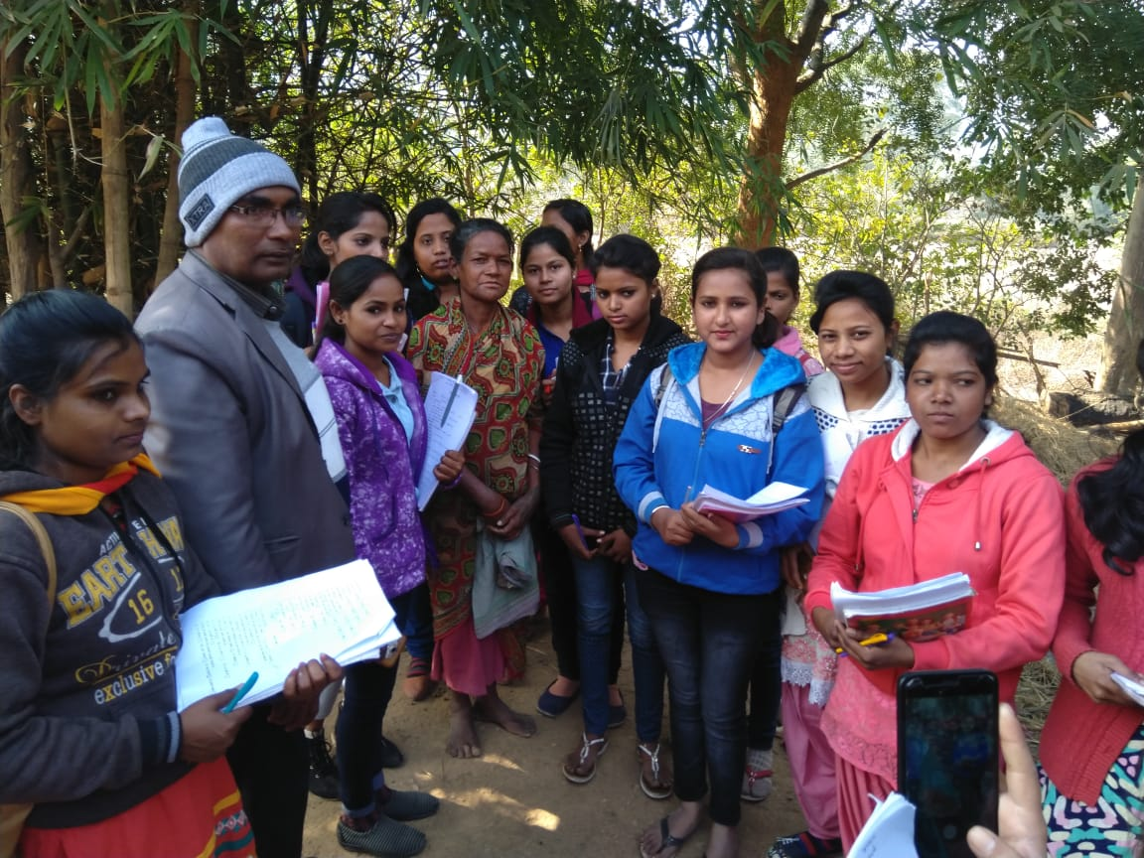
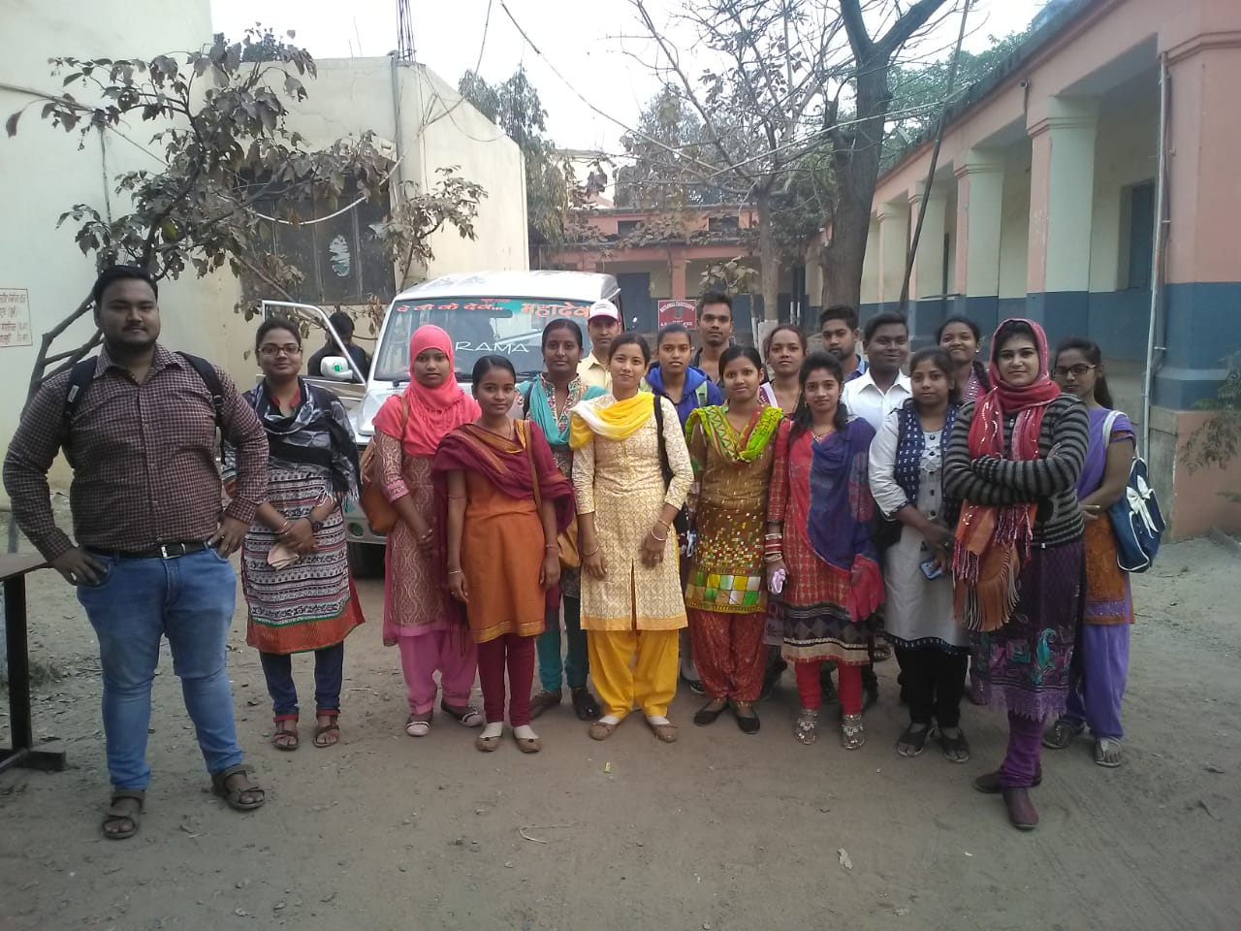
EXTRA CURRICULAR ACTIVITIES OF THE DEPARTMENT
EDUCATIONAL EXCURSIONS – Few Snapshots

Slide 31
INFRASTRUCTURE FACILITIES
Library Facility
Computer Lab Cum Conference Hall with internet
Smart Classroom

Slide 32
MEMBERSHIP OF FACULTIES IN THE COLLEGE
Dr. Sanjay Kumar Jha
Coordinator, Cleaning Committee
Member, Admission Committee
Member, Sports Committee
Dr. Utpal Kumar Chakraborty
AISHE
Member, Legal Cell

Slide 33
DEPARTMENTAL EXPENCES
in Rs.
 | YEAR
EVENTS/ITEMS | 2018 | 2019
SEMINAR | 10,000 | --
MISELINIOUS |  | 5,000
TOTAL | 10,000 | 5,000

Slide 34
OUR
PRIDE
ADLINA TIRKEY
2013-2016
Roll No. 14A-H012078084 1SOCIOLOGY
(HONS) UNIVERSITY TOPPER

Slide 35
OUR
PRIDE
JYOTI KUMARI
2011-2014
Roll No. 12A-H012003163 43579
SOCIOLOGY
(HONS) UNIVERSITY TOPPER

Slide 36
STRENGTH OF THE DEPARTMENT
1.SINCERE STUDENTS
2.COMMITTED FACULTY
3. DEDICATED STAFF MEMBERS
4. EQUAL OPPORTUNITY
5. SUPPORTIVE ADMINISTRATION

Slide 37
WEAKNESS OF THE DEPARTMENT
1.NO POST GRADUATE DEGREE
2.LIMITED MARKET FOR RECUITING STUDENT
3. LACK OF PRACTICES FOR STUDENTS
4. LACK OF SCOPE FOR RESEACRH
5. LACK OF STAFF

Slide 38
OPPORTUNITIES OF THE DEPARTMENT
1. LINKEAGES WITH NATIONAL PROFESSIONAL BODIES
2. LINKEAGES WITH INTERNATIONAL PROFESSIONAL BODIES
3. LOCATED IN INDUSTRIAL CITY
4. SPECIALIZATION IN INDUSTRIAL AND URBAN SOCIOLOGY

Slide 39
CHALLANGES OF THE DEPARTMENT
1. HIGH COMPETITION
2. DIFFICULTY IN UNDERSTANDING GLOBAL CULTURE
3. ECONOMIC UNCERTAINTY

