Slide 1
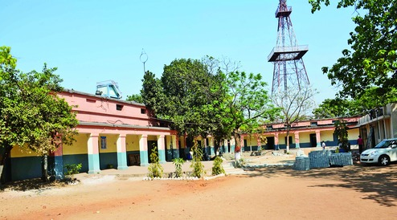
A.B. M. COLLEGE
GOLMURI , JSR - 831003
HEARTY WELCOME TO NAAC PEER TEAM
Department of Philosophy , ABM COLLEGE

Slide 2
DEPARTMENT OF PHILOSOPHY
A PROFILE
YEAR OF ESTABLISHMENT - 1979
IT OFFERS ug B.A.(HONS) PROGRAM AND B.A.(GEN).
PHILOSOPHY AS GENERAL ELECTIVE SUBJECT CAN ALSO BE TAKEN WITH OTHER B.A.(HONS) SUBJECTS .
Department of Philosophy , ABM COLLEGE

Slide 3
OUR MISSION
To provide education not only to acquire knowledge but also to inculcate a sound philosophy for a holistic living .
It is our aim and duty to create a basic foundation of morality among the youth through which we can create good and noble citizens of india
Department of Philosophy , ABM COLLEGE

Slide 4
OUR VISION
Our vision is to encourage students to study the subject Philosophy and improve their moral ethical values for creating a new and better INDIA .
To impart quality education
To provide a platform to the students to exhibit their talents and develop as good human being.
Department of Philosophy , ABM COLLEGE

Slide 5
No. of Teaching Post: 01
SANCTIONED | FILLED
01 | 01
DR. SONI SINHA - GUEST FACULTY (Contractual)
Department of Philosophy , ABM COLLEGE

Slide 6
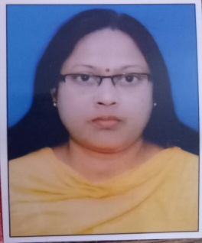
FALCULTY PROFILE
1 | Name of the faculty | Dr. SONI SINHA
2 | Qualification | MA, B.ED , Ph .D
3 | Designation | Assistant Professor (Contractual)
4 | No of years of experience | 05
5 | State level seminar attended | 02
6 | National level seminars attended | 02
7 | National level conferences attended | 02
8 | National/State level paper presented | 06
Department of Philosophy , ABM COLLEGE

Slide 7
RESEARCH & PUBLICATIONS OF PAPER DONE BY FACULTY
TITLE OF RESEARCH | NAME OF JOURNAL | ISSUE OF JOURNAL | STATUS OF JOURNAL
1. जैन अहिंसावाद को गाँधी की देन | अनुसन्धान | 2001 | PAPER PUBLISHED
2. प्राचीन एवं आधुनिक पर्यावरणीय चेतना | दार्शनिक त्रिमासिक | 2007 | PAPER PUBLISHED
3. जैन तथा गाँधीय के अहिंसा विचारों का तुलनात्मक अध्ययन | ANUSILANA | VOL. LXIII (2015) | ISSN 0973-8762
4. बौद्ध दर्शन एवं धर्म में विज्ञानपरक अवधारणा | VIMARSH | VOL.3 (2015) | ISSN 2393-9559
5. पर्यावरण एवं परिस्थिति की नैतिकता |  | 2016 | PAPER PRESENTED
6. भारतीय नीतिशास्त्र में सद्गुण |  | 2017 | PAPER PRESENTED
7. प्राचीन भारतीय दर्शन में पंचमहायज्ञ | LALITHA | VOL.X (2018) | ISSN 0975-6256
Department of Philosophy , ABM COLLEGE

Slide 8
TOTAL NO STUDENTS IN LAST YEARS
YEAR | FEMALE | MALE | TOTAL
2013-14 | 3 | 5 | 8
2014-15 | 0 | 1 | 1
2015-16 | 1 | 2 | 3
2016-17 | 2 | 7 | 9
2017-18 | 0 | 0 | 0
2018-19 | 1 | 1 | 2
Department of Philosophy , ABM COLLEGE

Slide 9
PASS FAIL GRAPH
YEAR | PASS | FAIL
2013-14 | 4 | 4
2014-15 | 1 | 0
2015-16 | 2 | 0
2016-17 | 9 | 1
2017-18 | 0 | 0
2018-19
Department of Philosophy , ABM COLLEGE

Slide 10
DIVERSITY OF STUDENTS
NAME OF COURSE | % OF STUDENTS FROM THE SAME STATE | % OF STUDENTS FROM THE OTHER STATE | % OF STUDENTS FROM ABROAD
B.A. (HONS) | 100% | NIL | NIL
B.A. (GEN) | 100% | NIL | NIL
Department of Philosophy , ABM COLLEGE

Slide 11
METHOD OF TEACHING
USE OF Chalk – talk method
Assignments
Seminars
Class tests
Provide study materials
Group discussions
Department of Philosophy , ABM COLLEGE

Slide 12
Innovative Teaching Methods …..
Seminar :
Students select the topic of their choice and put their views on . The objective of the departmental seminars was to develop a practice for speech and generate new ideas and to improve interest in study topics.
Remedial classes :
Identify slow learners / and provide extra guidance and study materials .

Slide 13
SWOC ANALYSIS……
STRENGTHS :-
Sufficient Reference books
Extra classes organized
Close relationship with students
Efficient and sincere faculty members
WEAKNESS :-
Poor communication skill in both verbal and non verbal skills .
2. Deteriorating students strength in course .
Department of Philosophy , ABM COLLEGE

Slide 14
SWOC ANALYSIS……
Opportunity & Challenges :-
To ensure all students perform well academically and achieve their goals and also increase no. of students in subjects .
Accepting , adapting and updating the teaching & learning techniques
Future plans:-
Publishing college magazine and organize national seminar
Department of Philosophy , ABM COLLEGE

Slide 15
Future plans
Publishing college magazine and organize national seminar
Department of Philosophy , ABM COLLEGE

Slide 16
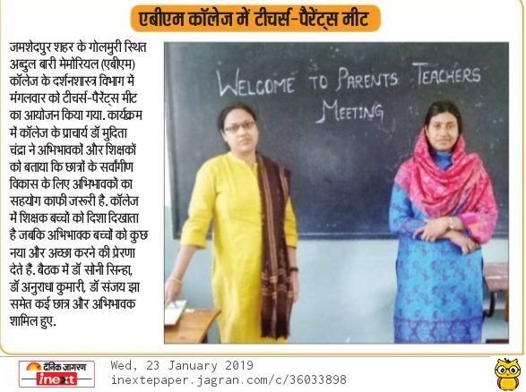
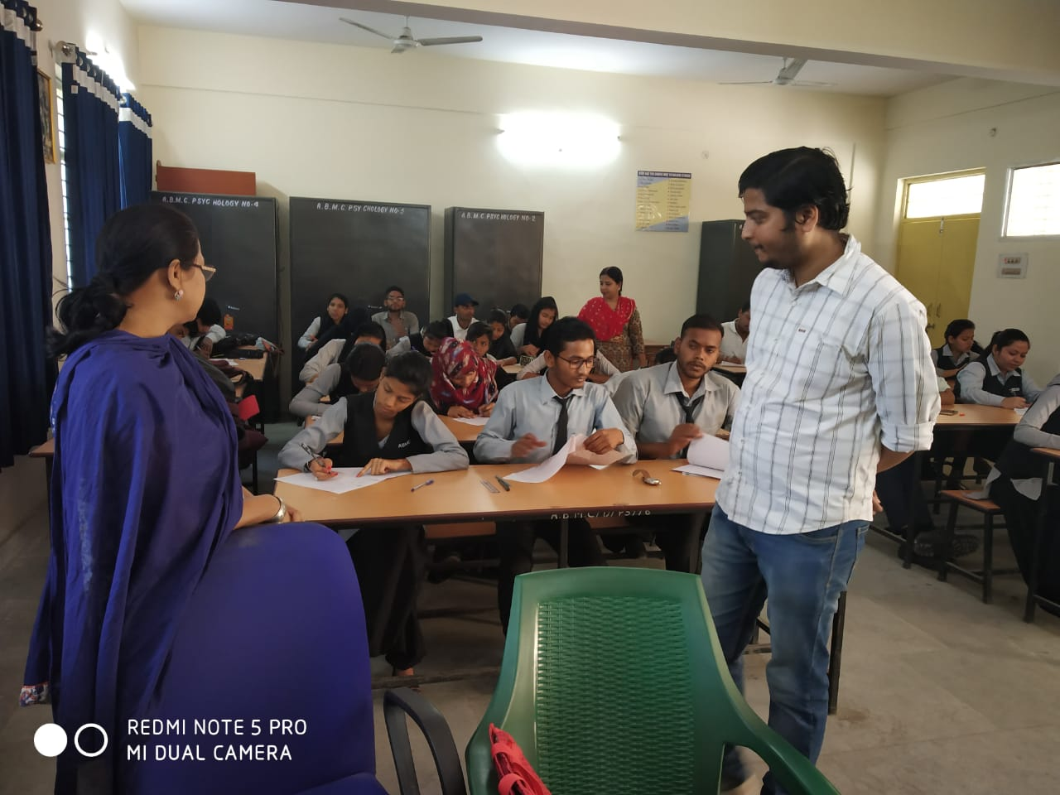
Departmental Activities
Department of Philosophy , ABM COLLEGE

Slide 17
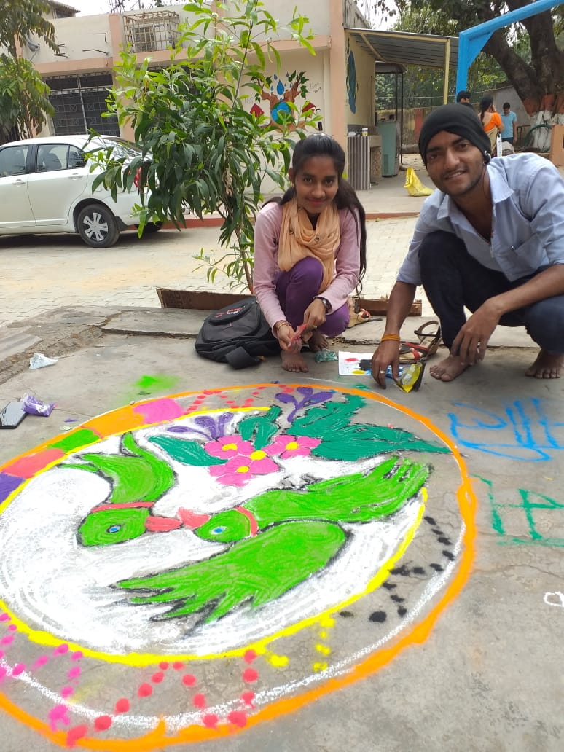
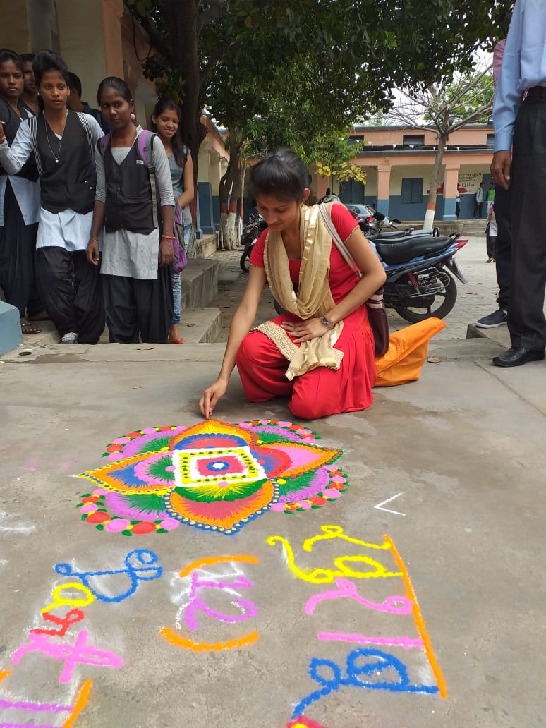
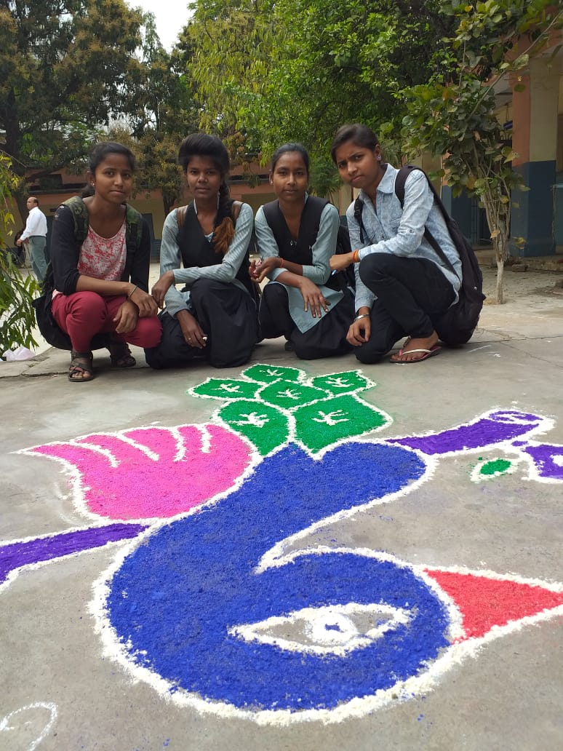
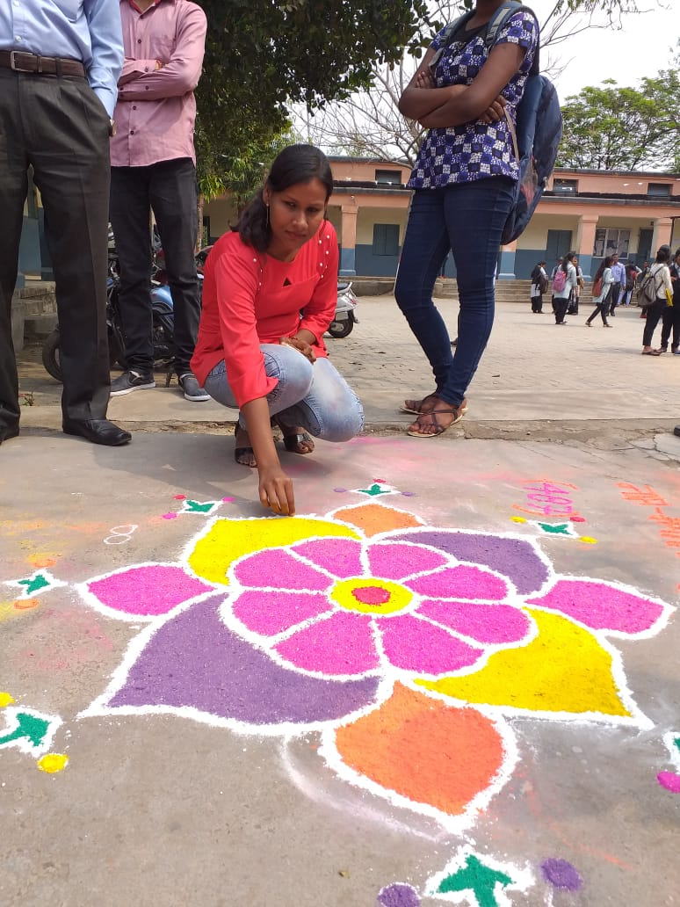
RANGOLI COMPETITION
Department of Philosophy , ABM COLLEGE

Slide 18
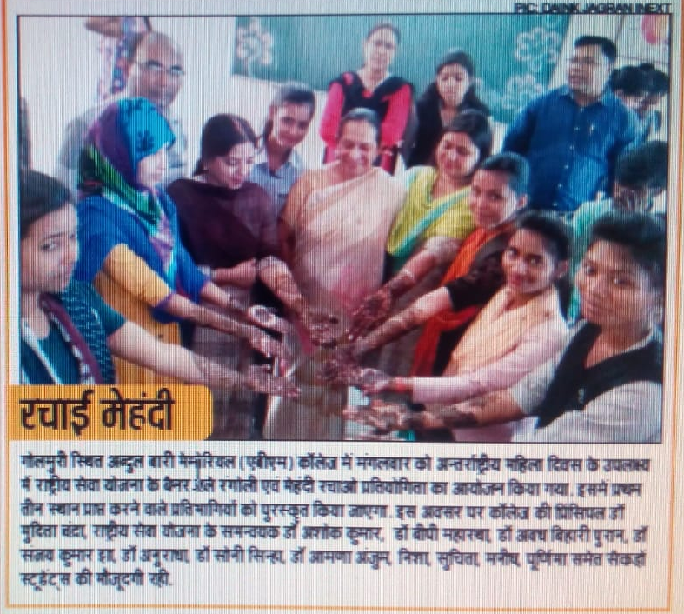
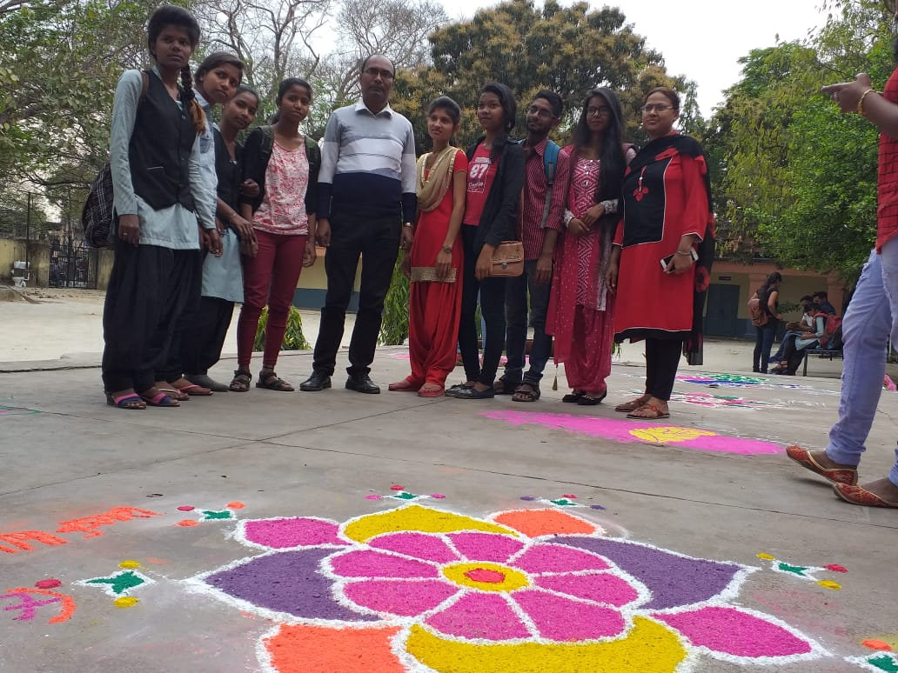
MEHNDI COMPETITION ON WOMENS DAY
Department of Philosophy , ABM COLLEGE

Slide 19
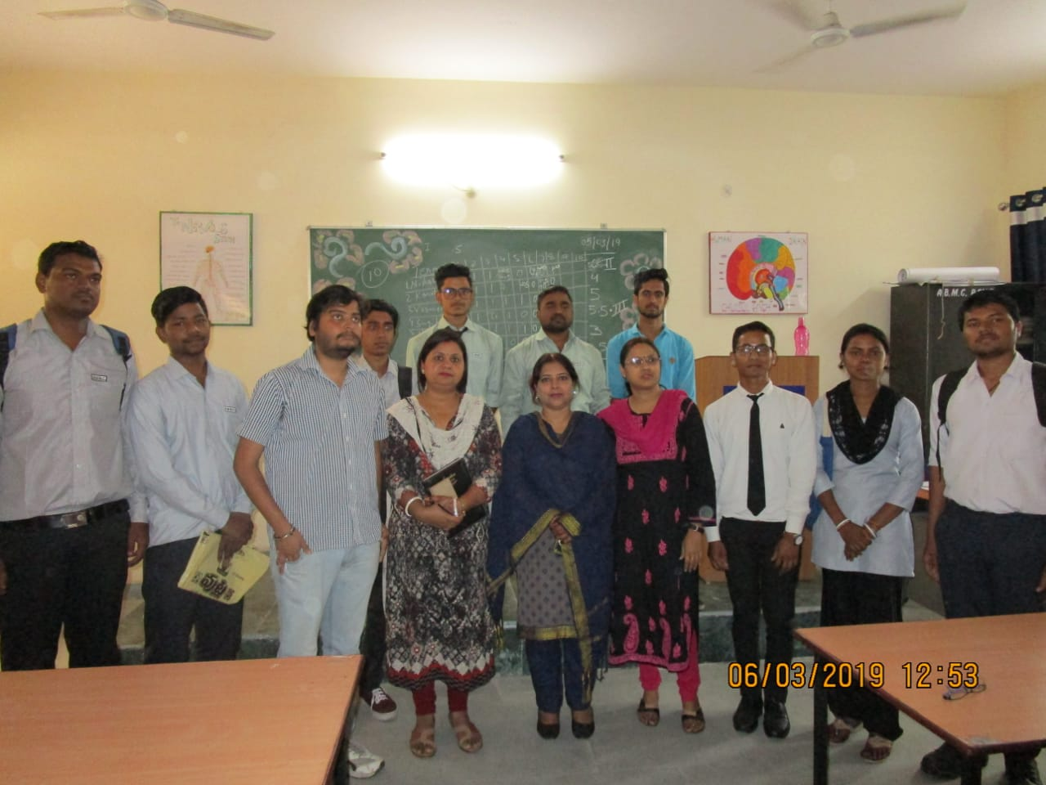
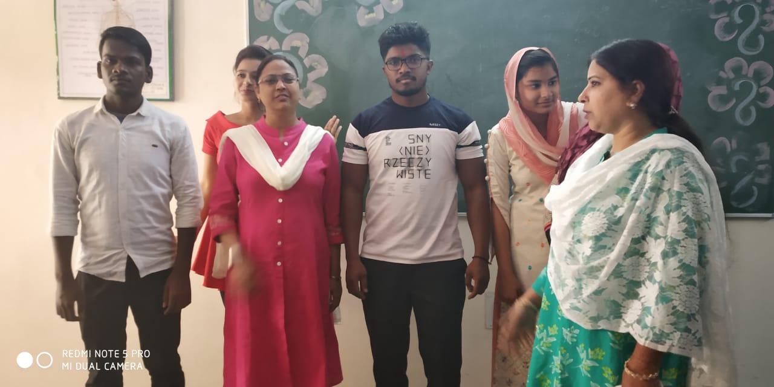
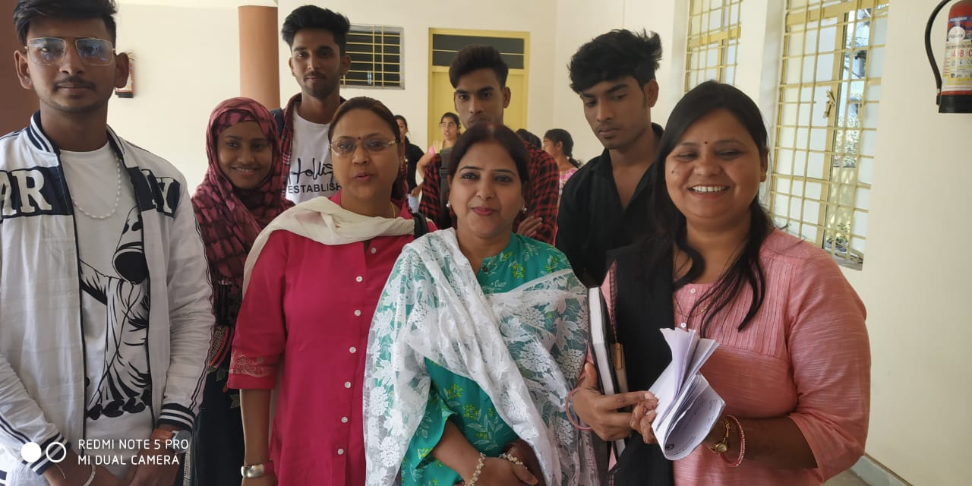
QUIZ CONTEST
Department of Philosophy , ABM COLLEGE

Slide 20
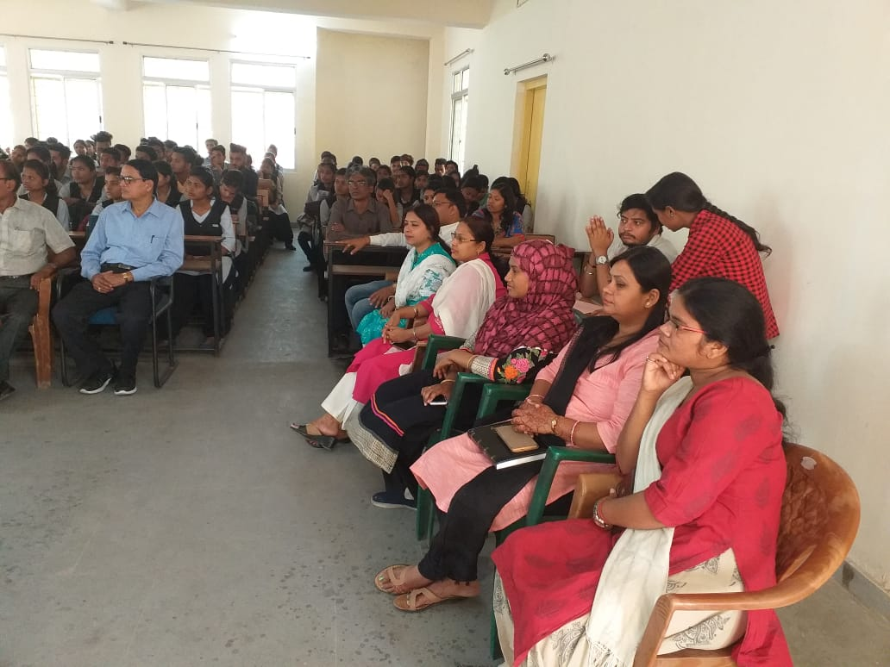
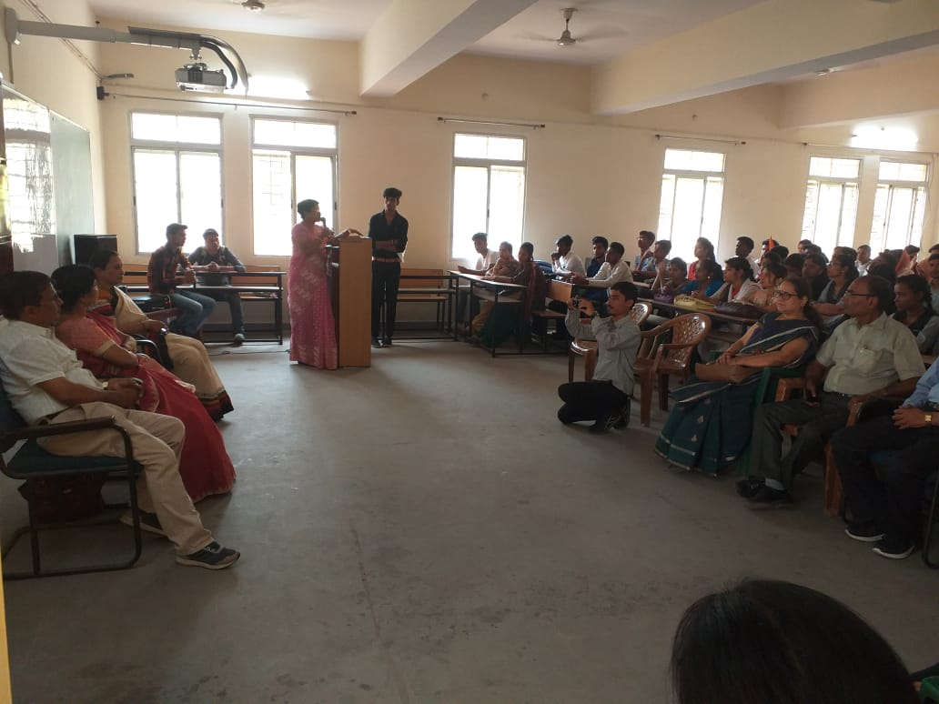
VOTER AWARENESS PROGRAMME

Slide 21
Department of Philosophy , ABM COLLEGE

